Slide 1
CeliacPlus: A Nutrition-Based Mobile Phone Application for the Management of Celiac Disease
Presentation by:
Maryam Ekramzadeh
Assistant Professor of Nutritional Sciences
Department of Clinical Nutrition
School of Nutrition and Food Sciences
Shiraz University of Medical Sciences, Shiraz, Iran

Slide 2
Saeed Sherafatmanesh , Ali Bakhshi , Najmeh Maayeshi , Naser Honar , Manoosh Mehrabi , Maryam Ekramzadeh
Shiraz International mHealth Congress
SIM Congress
February 16-18, 2021
Shiraz University of Medical Sciences, Shiraz, Iran

Slide 3
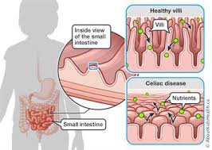
Background
Celiac disease (CD) is the most recognized inflammatory small intestine disorder that occurs as a result of an immune response to ingested gluten proteins of wheat, barley, and rye in genetically predisposed individuals.

Slide 4
Adhering to a strict gluten-free (GF) diet is required to be assured of nutritional sufficiency and prompt healing the CD manifestations. Therefore, regarding the popularization of mobile technologies, using mobile health (mHealth) applications provide a favored opportunity to encourage patient interest in personal nutrition education and disease symptomatology.

Slide 5
Objective
The goal of our study was to develop a Persian-language smartphone application (CeliacPlus; C⁺) by user-centered design for individuals with CD, to improve adherence to GF diet and enhance patients` knowledge.

Slide 6
Material and Methods
This project was a developmental-applied study which involved three phases of analysis, design, and development.
At first, a scientific review was performed on existing CD related mobile applications. Also, celiac patients were consulted to realize their preferences, barriers, and facilitators in the use of mHealth. Then, the main learning menu of C⁺ was designed based on the collected information. Eventually, the final version of C⁺ was developed under the supervision of the team consists of nutritionists, gastroenterologist and expert app developers.

Slide 7
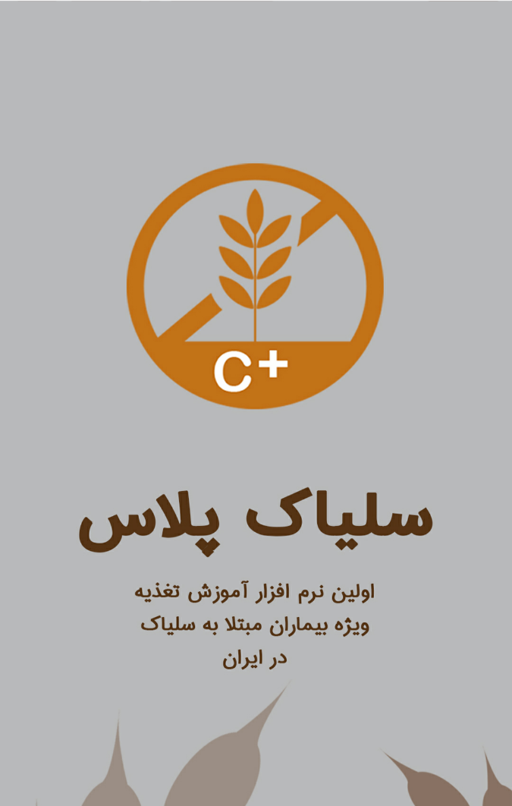
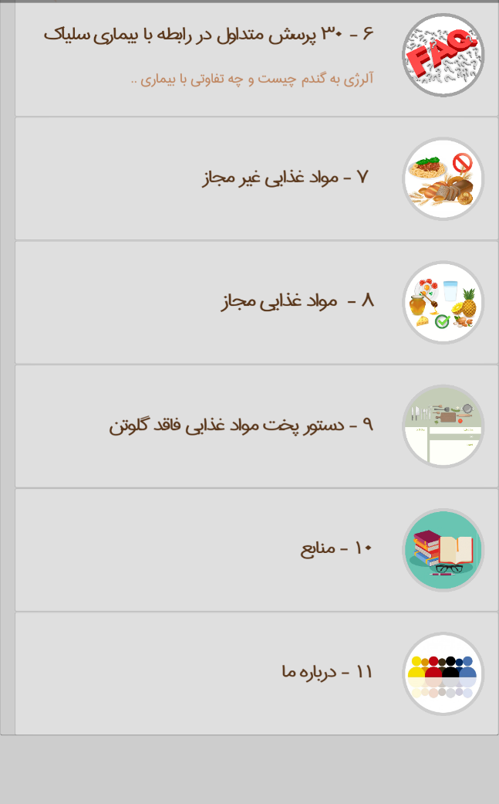
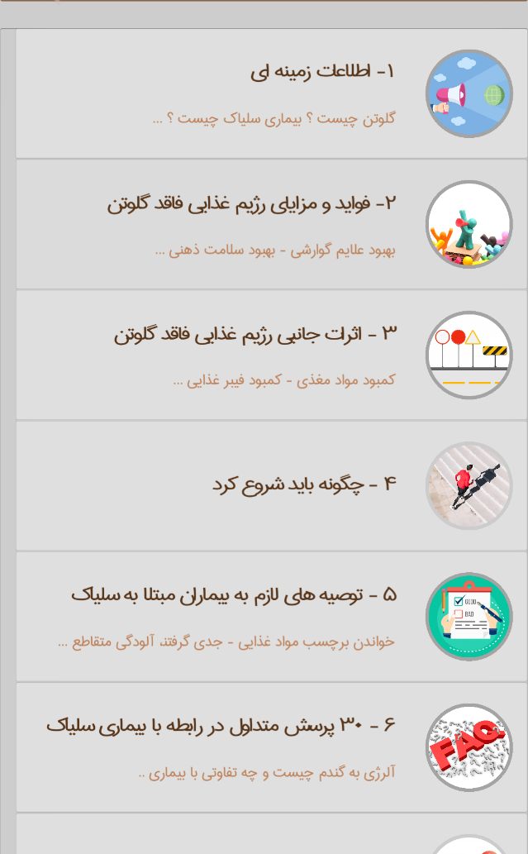

Slide 8
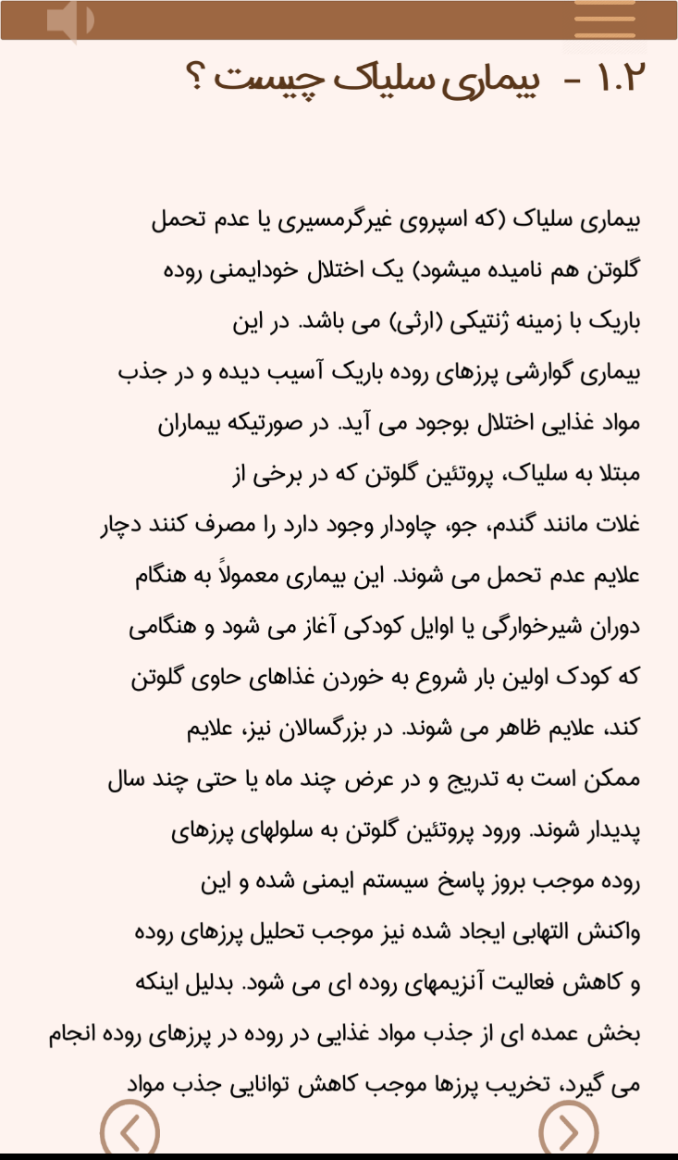
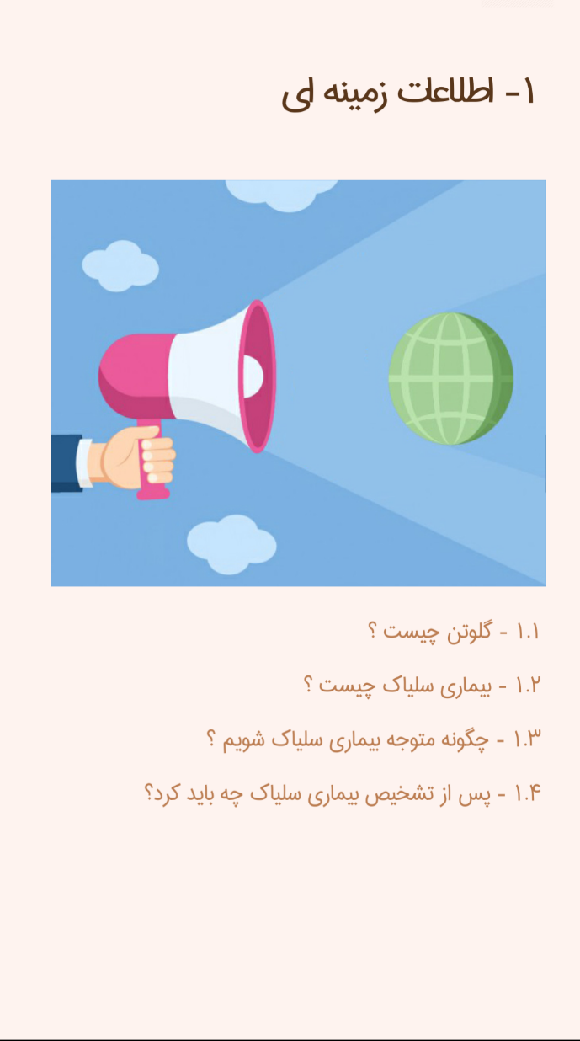

Slide 10
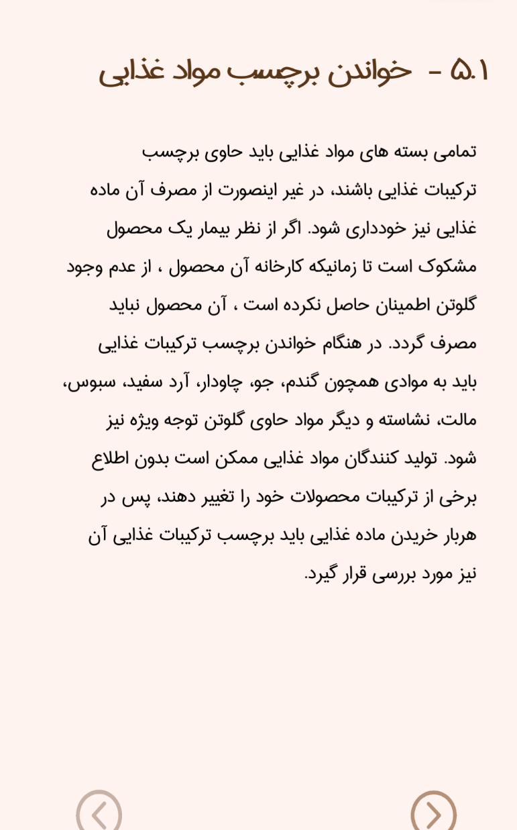
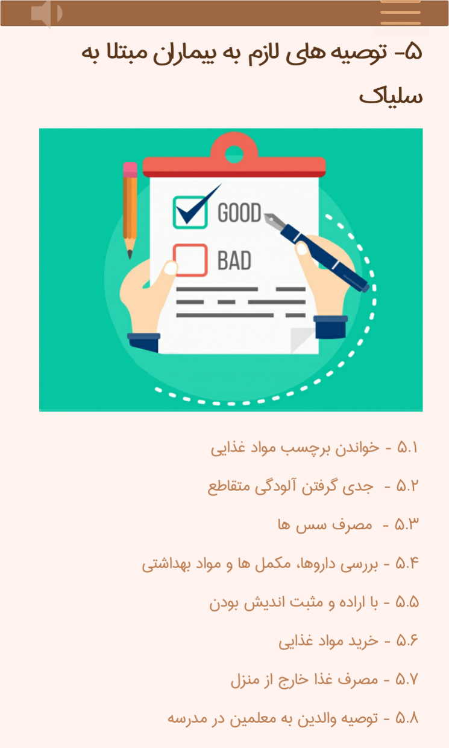

Slide 11
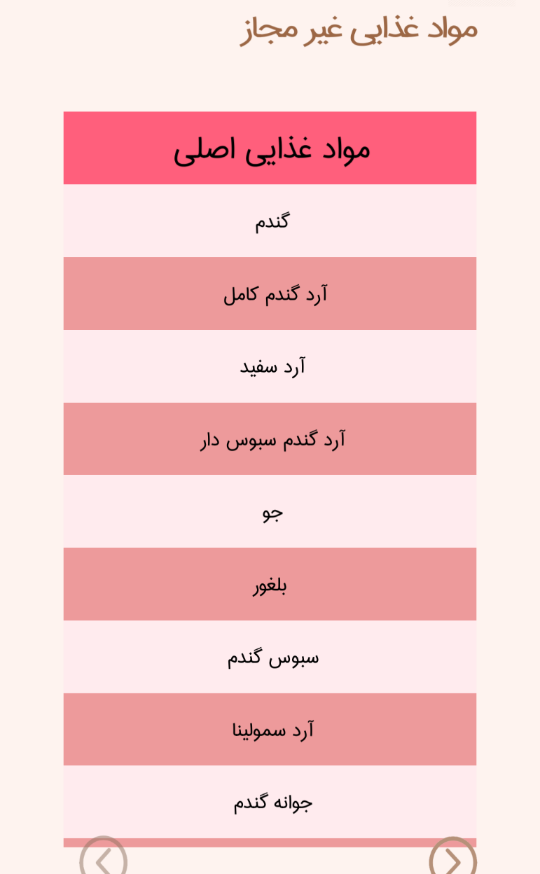
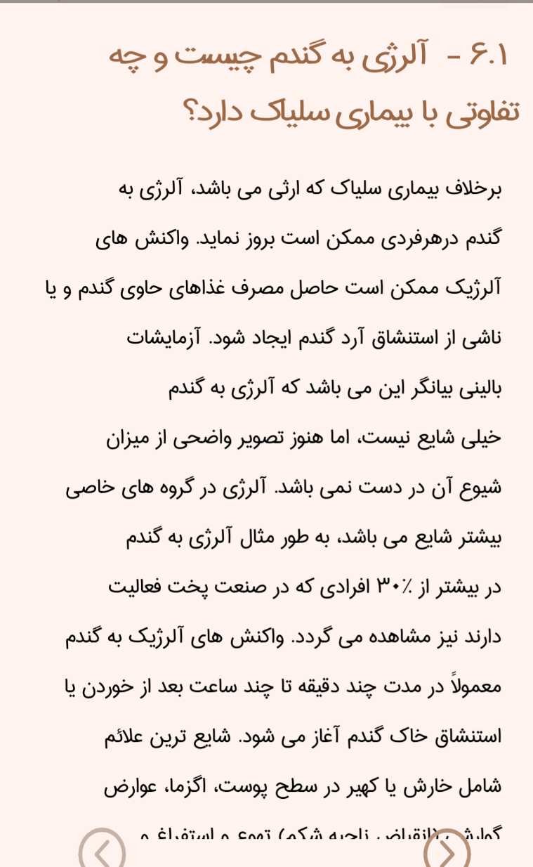

Slide 12
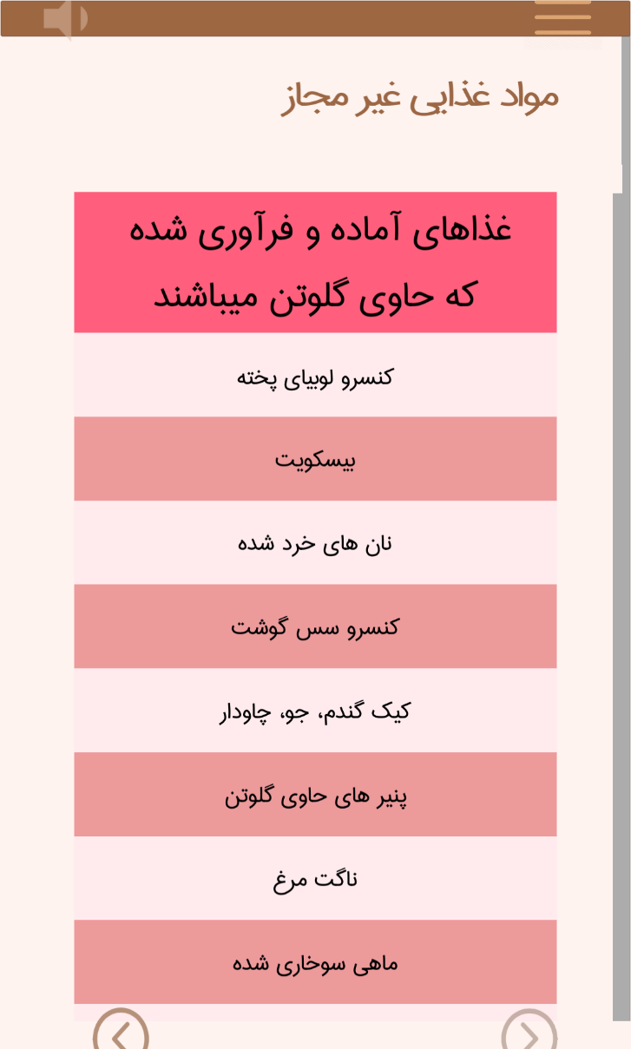
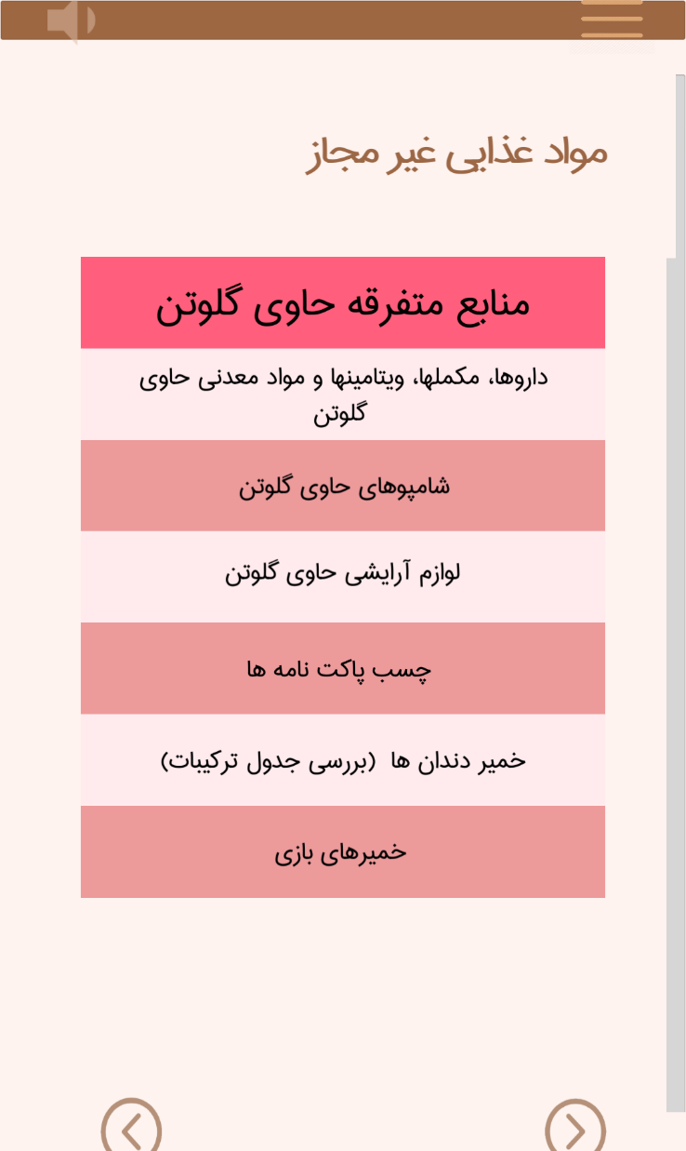

Slide 13
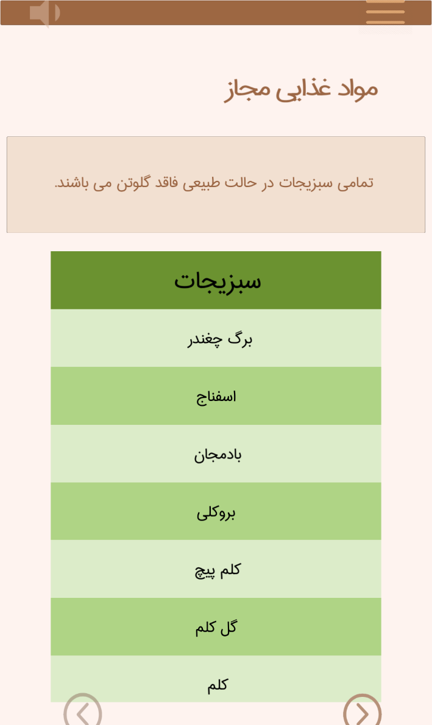

Slide 14
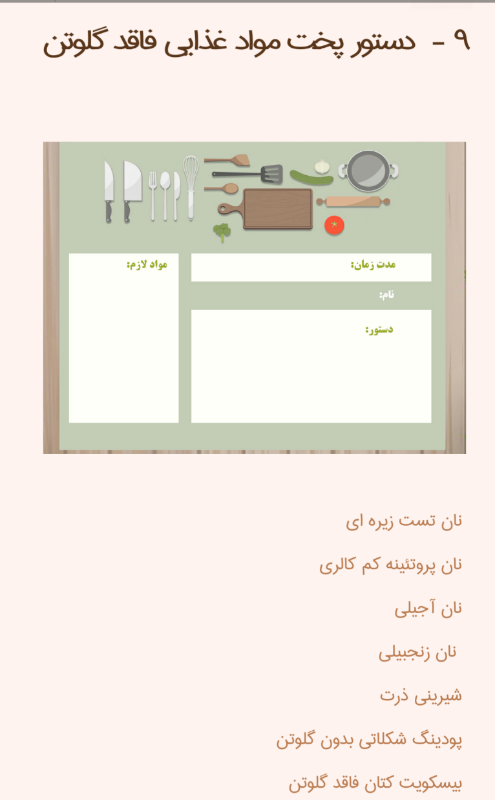
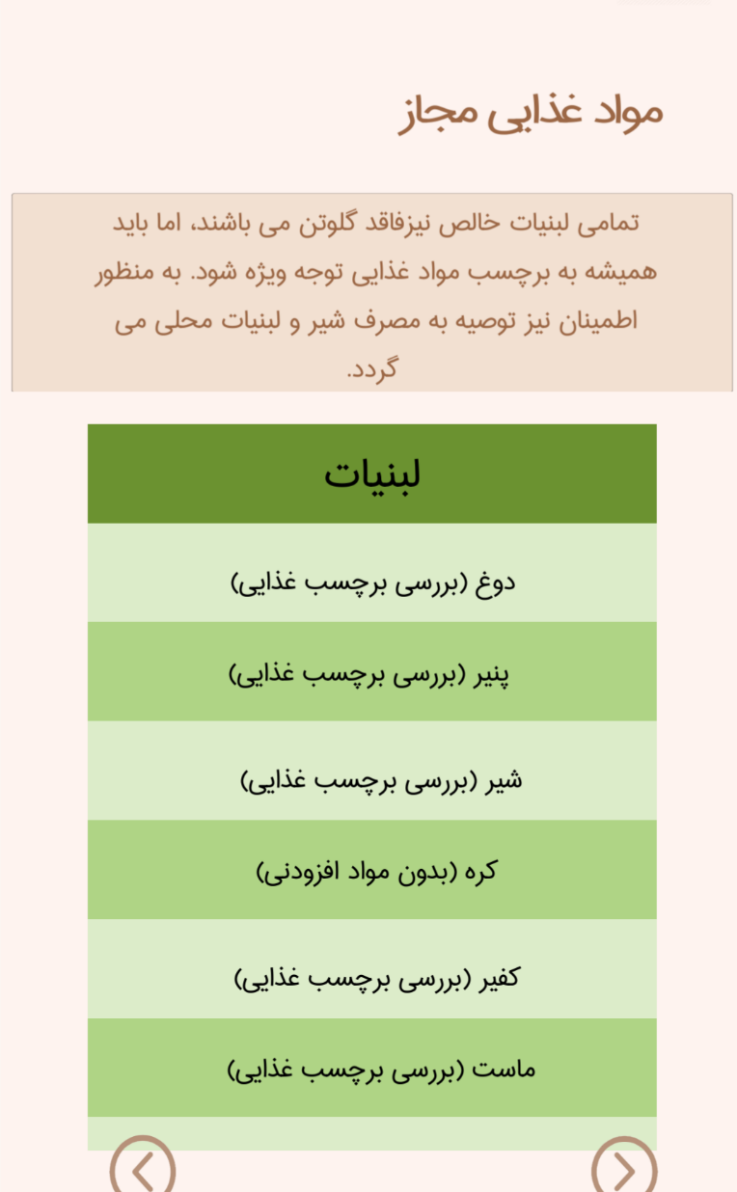

Slide 15
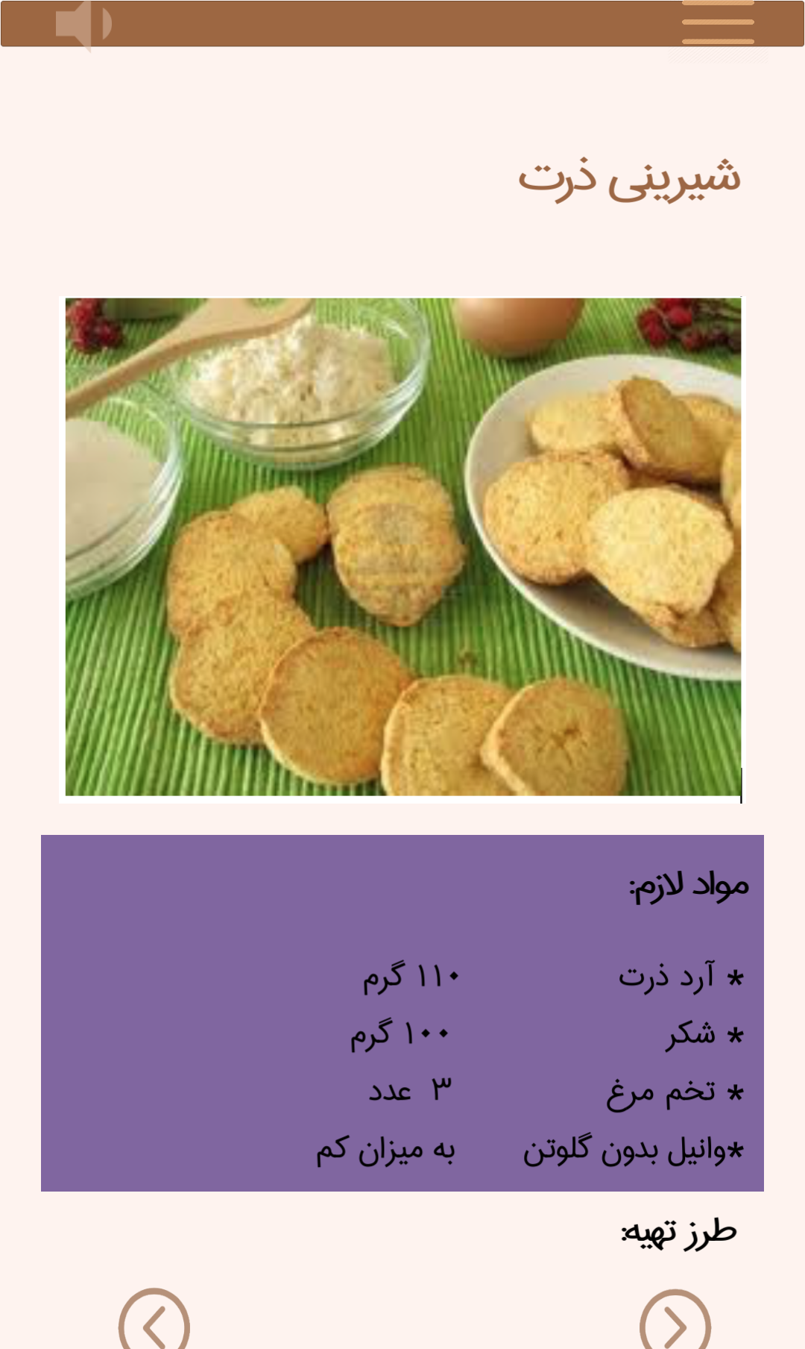
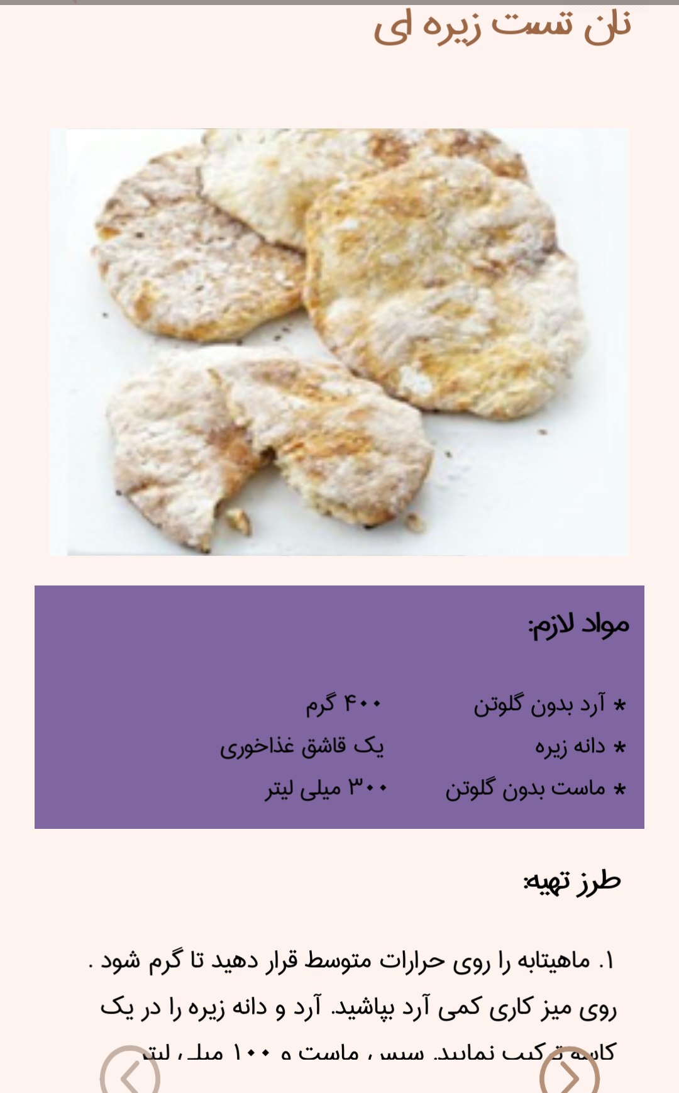

Slide 16
Results
The mobile software can provide consumers with easy-to-understand nutrition information, FAQs, and practical tips for the disease management and also support the selection of GF choices when shopping or cooking food.

Slide 17
Conclusion
C⁺ may be a potentially helpful approach in empowering patients to acquire self-care abilities and ensure overall gut health.

