Slide 1
IN THE NAME OF GOD

Slide 2
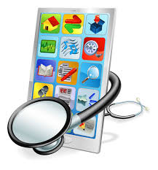
mHealth in Rehabilitatin during last decade

Slide 3
Zahra Rojhani-Shirazi
Professor of Physical Therapy
Shiraz University of Medical Sciences
Faculty of Rehabilitation
Department of Physical therapy

Slide 4
Telemedicine
The exchange of medical information through electronic communication in order to improve patient’s clinical health status
Multiple forms of electronic communication:
including phone calls, emails, text messages, video conference calls, mobile applications, and interactive websites
Variety of telemedicine uses :
preserving and maintaining health including symptom management, screening services, monitoring of disease activity , self-management programs for chronic diseases such as diabetes mellitus, COPD,..
Mobile applications using method of telemedicine

Slide 5
*Introduction
- 91% of adults are using cell phones
-The role of mobile health technology in healthcare is steadily growing
-2015 500 million people healthcare application

Slide 6
mHealth
Within years of the 21st century, we have witnessed remarkable technological progress with the developments of powerful and portable computing devices
What is mHealth?
Diverse application of wireless and mobile technologies designed to improve :
-health research
- health care services
- health outcomes
*mHealth has the potential to reduce the cost of health

Slide 7
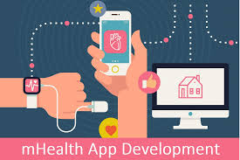
mHealth in rehabilitation

Slide 8
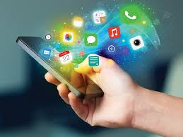
*The category of health-related apps has seen significant growth:
In 2010 5800 apps health and wellness
In 2013 17,000 medical apps free to the consumer
By 2015 500 million people medical apps
By2021 1.5. mobile devices mobile phones are the most popular technology

Slide 9
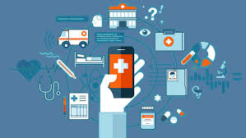
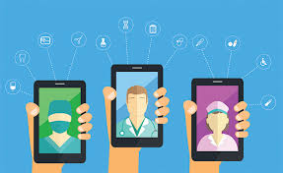
Categorization of the mobile applications:
Lifestyle-oriented apps
Patient-oriented apps
Clinician-oriented apps
mHealth systems
*Major point in all aspects is accessibility

Slide 10
The studies evaluating apps as interventions showed
positive effects
Gait
Mobility
self-management
skills
Quality
of life
Pain
Symptoms

Slide 11
Stroke apps:
lifestyle-oriented app physical activity step count, walking time, fatigue
patient-oriented apps functional outcomes, high satisfaction, language function
A valid and reliable tele-screening tool aphasia

Slide 12
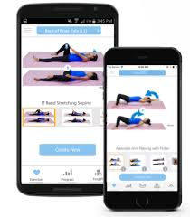
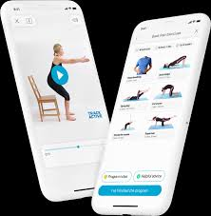
Musculoskeletal apps
Facilitated knee rehabilitation
Prevented ankle sprain recurrence
Facilitated wrist and/or hand rehabilitation
Improving their sit-to-stand motion
Osteoarthritis index
Rheumatoid arthritis

Slide 13
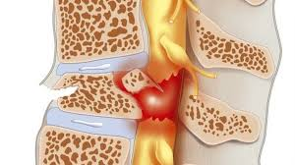
Spinal cord injury apps
Spina bifida (self management)
Virtual coaching system(for users of electric powered wheelchairs to remind …)

Slide 14
Traumatic brain injury apps
Facilitating planning of appointments
Evaluating mood-related symptom
Improving cognitive memory
Facilitating the use of transportation systems
Home-based rehabilitation program
Notes:
PADs=Personal digital assistants as cognitive aidsis a term for a small, mobile, handheld device that provides computing and information storage and retrieval capabilities for personal or business use, often for keeping schedules, calendars and address book information handy.

Slide 15
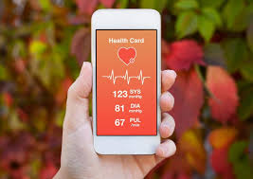
Cardiac apps
Facilitating cardiac rehabilitation in the home setting
Exercise
Symptom monitoring
Physical activity monitoring (via GPS technology, electrocardiogram, and vitals assessment)
Behavior modification
Assessment of symptoms following discharge from the hospital
Questionnaire measuring physical activity

Slide 16
Pulmonary apps
Facilitating home-based exercise rehabilitation
Enabling self-management
Supporting self-management of dyspnea
Facilitating exercise training programs
COPD
higher exercise capacity
increased physical activity outcomes
reducing dyspnea
decreased serum inflammatory

Slide 17
Neurological apps
Assessing or improving the gait Parkinson disease, cerebral palsy
Assisting with cognitive rehabilitation Multiple sclerosis
Quality of life questionnaire Children with neuromuscular conditions
Gaze stabilization training Vestibular hypofunction

Slide 18
Nonspecific and general rehab apps
Three apps focused on improving:
balance
strength
mobility
cognition
phone strapped to the lower back that collected motion data about trunk tilt while providing audio feedback
Mobile-based augmented mental and physical activities depending on rehabilitation needs
Interactive games designed to deliver fall prevention exercises while using the mobile phone as a motion sensing

Slide 19
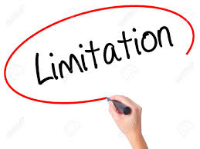
Three limitations of the studies in mHealth:
Low RCTs design
Small participant populations
Focused on adult rehabilitation

Slide 20
Three main paths for using mHealth in the real world:
To identify new methods for patient beneficial and measurable behavioral changes
To develop the necessary tools to streamline clinical integration and data analytics
To identify the regulatory factors that promote the most effective technologies for clinical use.

Slide 21
Future recommendations:
Apps as interventions
RCTs
Wide range of outcomes:
health-related outcomes
functional outcomes
participation and psychosocial outcomes
Data security and electronic health record (EHR) integration
Apps intended to support pediatric or vulnerable populations
Apps for medical and rehabilitation care in developing nations

Slide 22
*Some references:
-Mobile Health Technology Evaluation. Am J Prev Med. 2013 August ; 45(2): 228–236
-Mobile-health: A review of current state in 2015. Journal of Biomedical Informatics 56 (2015) 265–272
-Mobile technology and the digitization of healthcare. European Heart Journal (2016) 37, 1428–1438
-Telemedicine and Mobile Health Technology Are Effective in the Management of Digestive Diseases: A Systematic Review. Digestive Diseases and Sciences (2018) 63:1392–1408
-Systematic Review of Mobile Health Applications in Rehabilitation. Archives of Physical Medicine and Rehabilitation 2019;100:115-27

