Slide 1
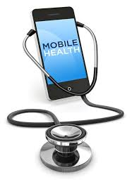
The role of m-health in elderly self-care during the Corona epidemic: A review study
Mohammad Hossein Kaveh, PhD
Maryam Rabiey, MSc
Sara Kaveh, MSc
MH4-04520368

Slide 2
Introduction
The elderly people!
a large and growing population
Suffering from chronic diseases
Comorbidities
cost of medical treatments and the usage of health care services
quality of life
...
Notes:
The elderly are a large and growing population in the world whose cost of medical treatments and the usage of health care services are high, because most of them suffer from chronic conditions such as hypertension, diabetes, cardiovascular diseases, respiratory problems, and cancer (Borrero et al., 2015; Thomas-Purcell et al., 2019). Comorbidity and its subsequent medical treatments reduce people’s quality of life and self-efficacy, which, in turn, lead to psychological problems such as depression (Dallosso et al., 2018; Guo et al., 2017). The importance of maintaining the quality of life in the elderly and the increasing cost of financial and human resources required to take care of them has become a major issue (Dupuis & Tsotsos, 2018).

Slide 3
Problems with health care services
Access (also, availability, affordability, appropriateness, acceptability)
Utilization
Adherence

Slide 4
Access to and utilization of health services
Access to health services is considered a determinant of health inequalities [4].
In terms of the provision of such services, Tudor-Hart’s inverse care law [5] identified that population groups with the highest health needs -the most deprived and vulnerable groups in society- tended to receive the least health care provision, whilst those with the least health need -the most affluent and advantaged societal groups- received the most health care.
Agudelo-Suárez et al. BMC Health Services Research 2012, 12:461 http://www.biomedcentral.com/1472-6963/12/461
Notes:
A metasynthesis of qualitative studies regarding opinions and perceptions about barriers and determinants of health services’ accessibility in economic migrants Andrés A Agudelo-Suárez1,2*, Diana Gil-González2,3,4, Carmen Vives-Cases2,4, John G Love5 , Peter Wimpenny6 and Elena Ronda-Pérez2,4
Agudelo-Suárez et al. BMC Health Services Research 2012, 12:461 http://www.biomedcentral.com/1472-6963/12/461

Slide 5
Barriers to healthcare utilization among older people
Four main barriers to formal healthcare use were identified:
physical accessibility barriers (poor transport system and poor architecture of facilities),
economic barriers (low income coupled with high charges, and noncomprehensive nature of the National Health Insurance Scheme [NHIS]),
social barriers (communication/language difficulties and poor family support) and
unfriendly nature of healthcare environment barriers (poor attitude of healthcare providers).
Agyemang-Duah et al. BMC Public Health (2019) 19:1185 https://doi.org/10.1186/s12889-019-7437-2
Notes:
Barriers to formal healthcare utilization among poor older people under the livelihood empowerment against poverty programme in the Atwima Nwabiagya District of Ghana Williams Agyemang-Duah1* , Charles Peprah1 and Prince Peprah2

Slide 6
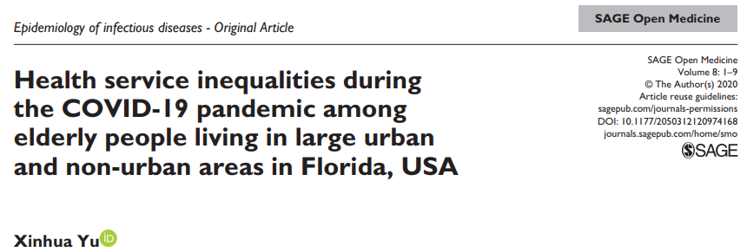
Unfortunately, as history has shown, health inequalities might be exacerbated during the emerging epidemic.
People with lower SES were more likely to have two or more chronic conditions than those with higher SES, and have limited access to health-care resources.
...
In summary, profound health inequalities between urban and non-urban areas existed in the time of emerging pandemic like COVID-19.
Notes:
For elderly people living in Florida, USA, those living in small metropolitan or rural areas were less likely to receive adequate health care than those living in large or medium metropolitan areas during the COVID-19 pandemic.

Slide 7
Medication nonadherence
Medication nonadherence for patients with chronic diseases is extremely common, affecting as many as 40% to 50% of patients who are prescribed medications for management of chronic conditions such as diabetes or hypertension.
This nonadherence to prescribed treatment is thought to cause at least 100,000 preventable deaths and $100 billion in preventable medical costs per year. Despite this, the medical profession largely ignores medication nonadherence or sees it as a patient problem and not a physician or health system problem.
Kleinsinger F. The unmet challenge of medication nonadherence. Perm J 2018;22:18-033. DOI: https://doi.org/10.7812/TPP/18-033

Slide 8
According to the World Health Organization, medication adherence can have a more direct impact on patient outcomes than the specific treatment itself.1 Medication adherence can affect quality and length of life, health outcomes, and overall healthcare costs.2,3 Nonadherence can account for up to 50% of treatment failures, around 125,000 deaths, and up to 25% of hospitalizations each year in the United States.
Typically, adherence rates of 80% or more are needed for optimal therapeutic efficacy. However, it is estimated that adherence to chronic medications is around 50%. Adherence rates can go down as time passes after the initial prescription is written, or as barriers emerge or multiply.
https://www.uspharmacist.com/article/medication-adherence-the-elephant-in-the-room#:~:text=Nonadherence%20can%20account%20for%20up,chronic%20medications%20is%20around%2050%25.
Notes:
The elderly are more at risk of medication adherence than the youth mainly due to a condition referred to as comorbidity, i.e. a condition in which the elderly suffers from several diseases at the same time and, subsequently, uses different drugs.
This may lead to disease aggravation, a need for a doctor visit or hospitalization, due to complications resulting from not taking or taking too much medicine (Toh et al., 2014; Yap et al., 2016).

Slide 9
Four modifiable risk behaviors
Chronic diseases are the most preventable of all health problems
“four modifiable risk behaviors:
lack of physical activity,
poor nutrition,
tobacco use, and
excessive alcohol consumption
all causes of mortality could be cut by 55% by never smoking, … (McKenzie, Neiger, & Thackeray. 2017).
Notes:
Chronic diseases are not only the most common, deadly, and costly, they are also the most preventable of all health problems in the United States (NCCDPHP, 2009).
They are the most preventable because “four modifiable risk behaviors—lack of physical activity, poor nutrition, tobacco use, and excessive alcohol consumption—are responsible for much of the illness, suffering, and early death related to chronic diseases”.
In fact, one study estimates that all causes of mortality could be cut by 55% by never smoking, engaging in regular physical activity, eating a healthy diet, and avoiding being overweight

Slide 10
Lifestyle factors
The combined impact of lifestyle factors, including tobacco smoking, excessive alcohol intake, physical inactivity, unhealthy diet, and obesity, on mortality has been prospectively evaluated mostly in western populations.
A meta-analysis showed that a combination of at least four healthy lifestyle factors lowered the all-cause mortality risk by 66% [7].
Zhu et al. International Journal of Behavioral Nutrition and Physical Activity (2019) 16:98 https://doi.org/10.1186/s12966-019-0860-z

Slide 11
Nonadherence to healthy lifestyle
Only 3% of U.S. adults adhere to four healthy lifestyle
If moderate alcohol use were included, the percentage would be even lower (McKenzie, Neiger, & Thackeray. 2017).
Notes:
One study (Reeves & Rafferty, 2005) has shown that only 3% of U.S. adults adhere to four healthy lifestyle characteristics (not smoking, engaging in regular physical activity, maintaining a healthy weight, and eating five fruits and vegetables a day).
If moderate alcohol use were included in the healthy lifestyle characteristics the percentage would be even lower (King, Mainous, Carnemolla, & Everett, 2009).

Slide 12
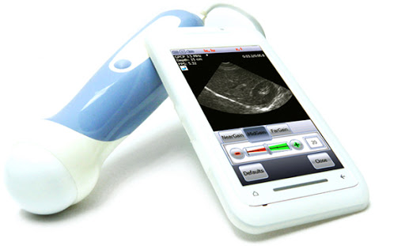
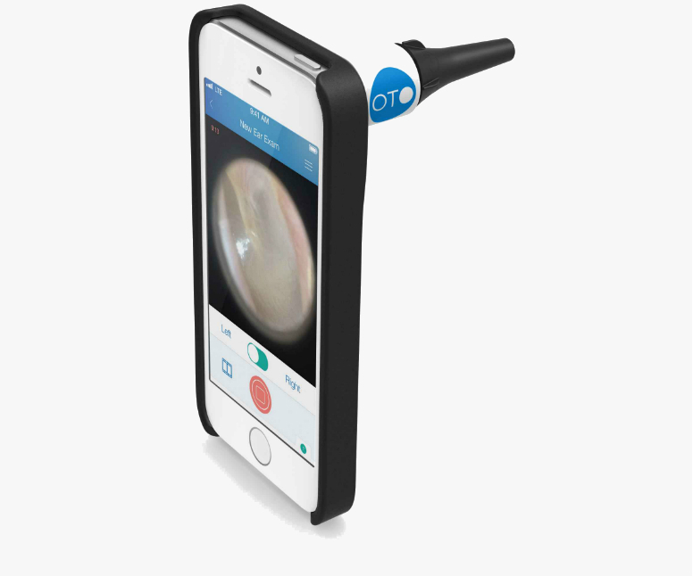
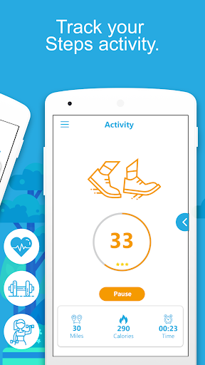
mHealth as a solution!
In this regard, one of the useful approaches is to use mobile health capabilities. ..
Notes:
In this regard, one of the useful approaches is to use mobile health capabilities. Mobile health is a medical and public health activity supported by mobile devices, laptops, tablets and computers (Kuerbis et al., 2017; Thomas-Purcell et al., 2019). Mobile health is a multi-purpose feature for storing, transmitting and receiving health information that acts as a hand-held or sometimes wearable transmitter.(Kuerbis et al., 2017).

Slide 13
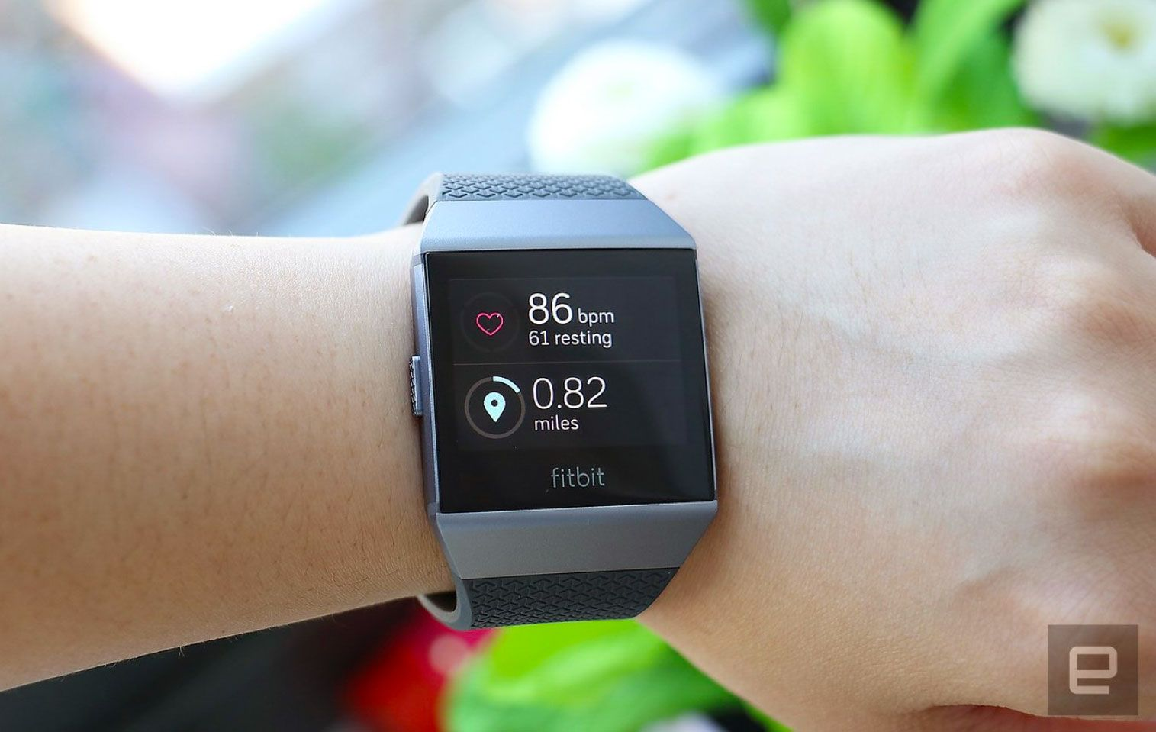

Slide 14
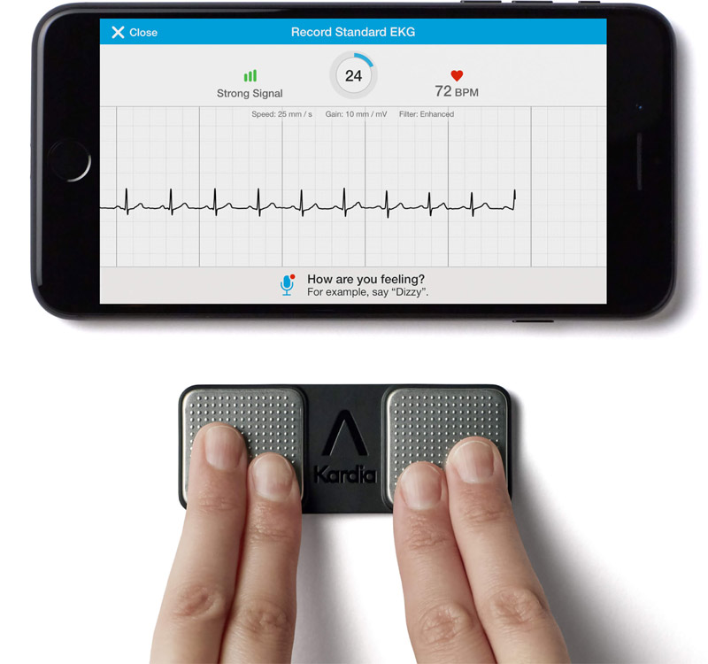

Slide 16
capabilities of mobile health
Advances in mobile health services in the medicine and health care can
increase self-management and treatment adherence in the elderly, which
lead to a wider and more appropriate relationship between patients, their caregivers and service providers, as well as
a reduction in complications and mortality (Borrero et al., 2015; Chouvarda et al., 2015; Dupuis & Tsotsos, 2018).
Promote self-care and treatment adherence
increases the quality of life and reduces the complications and costs (Johnston et al., 2016).
Notes:
Taking advantage of the capabilities of mobile health such as sending reminders to take drugs, improving patient-caregivers relationships, and the constant receiving of vital information about the patients through various sensors can reduce complications and mortality.
Moreover, mobile health can improve self-care.
Promoting self-care and treatment adherence increases the quality of life and reduces the complications and costs(Johnston et al., 2016).

Slide 17
smart phones; capabilities could be used
Monitoring symptoms,
receiving patient information about side effects of treatments,
sending reminders to the patient to take medication,
providing education,
communicating with the health providers, and
providing social support (Hardinge et al., 2015; Lakshminarayan et al., 2018; Levine & Reid, 2012).
Notes:
Today, smart phones are increasingly used by different groups of people, even the elderly. Therefore, taking advantage of mobile phones capabilities and their applications could be a promising and sustainable strategy to improve medication adherence and health outcomes for patients with chronic diseases. Monitoring symptoms, receiving patient information about side effects of treatments, sending reminders to the patient to take medication, providing education as well as self-care and self-management devices for the patient, communicating with the health providers, and providing social support are the capabilities of mobile health intervention (Hardinge et al., 2015; Lakshminarayan et al., 2018; Levine & Reid, 2012). So far, the effectiveness of these interventions in various diseases such as diabetes, hypertension, cardiovascular disease and cancer has been shown (Dale et al., 2015; Myoungsuk, 2019; Sun et al., 2019; van den Berg et al., 2015). In this study, we investigated various mhealth interventions in the elderly and their impact on promoting self-care and adherence. Because the focus of this study is on the consequences of self-care and adherence in the elderly, findings of this study can be effective for related programs researchers and designers.

Slide 18
The aim of the study
The present study is a review study which aims at investigating the extent to which using mobile health technology and any other available applications in this domain can be effective in improving self-care and treatment adherence in the elderly.

Slide 19
Methods
For this purpose, advanced search in reputable scientific resources such as Google Scholar, PubMed, Science Direct, Scopus, Web of Science, Magiran, SID, Iran Medex from January 1, 2015 (1/1/2015) to August 30, 2020 (8/30/2020) was performed.
To perform the search process, the keywords "adherence", "elder", "older adult", "mobile health", "medication", "self-care" and their Persian equivalents were used.

Slide 20
Methods
Initially, 336 articles were found. After removing duplicates, articles with an average age of over 50 years in which mobile health technology had been used to promote self-care and adherence were extracted. Then, the items that were both in Persian and English with their full texts available were selected.
Finally, by reviewing the titles of the articles and studying their abstracts, 20 articles that had the most relevance to the research study, were related to the use of mobile health technology in self-care and adherence, and were Randomized Clinical Trial (RCT) were selected and used.

Slide 21
Results
All studies were in English and the duration of interventions in different studies was between 8 weeks and 12 months.
A total of 3268 people (1731 in the intervention group and 1537 in the control group) participated in the studies.
Of these 20 studies,
heart diseases
type 2 diabetes
hypertension
pre-diabetes
breast cancer
cancer screening
colorectal
chronic obstructive pulmonary disease ....
Notes:
In this review, 20 RCT that have evaluated the impact of various mhealth interventions on self-care and adherence in the last 5 years, has been studied. All studies were in English and the duration of interventions in different studies was between 8 weeks and 12 months. The number of participants in both control and intervention groups varied from 5 to 176 people. A total of 3268 people (1731 in the intervention group and 1537 in the control group) participated in the study. Of these, 1418 were male (761 in the intervention group and 657 in the control group) and 1850 were female (970 in the intervention group and 880 in the control group) and all were over 50 years old. Of these 20 studies, two cases were about heart diseases (Dale et al., 2015; J. D. Piette et al., 2015), seven cases were about type 2 diabetes (Becker et al., 2017; Crowley et al., 2016; Dugas et al., 2018; Peimani et al., 2016; Sarayani et al., 2018; Sun et al., 2019; Tan et al., 2020), two cases were about hypertension (Kim et al., 2016; Myoungsuk, 2019), one case was about pre-diabetes (Griauzde et al., 2019), one case was about breast cancer (van den Berg et al., 2015), two cases were about cancer screening (breast (A. S. Anderson et al., 2018) and colorectal (Miller Jr et al., 2018), one case was about chronic obstructive pulmonary disease (Coultas et al., 2018), and four cases were combination of two diseases (Abaza & Marschollek, 2017; Fors et al., 2018; Frias et al., 2017; John D Piette et al., 2016). (Table 1)

Slide 22
Results: Types of mhealth interventions
... can be divided into 5 general groups including
message, call, application, device, and internet-based interventions.
In message-based interventions, educational or reminder messages are sent in the form of short message services (SMS), Long-message services (LMS), or emails to patients or their caregivers.
In telephone call interventions, providing training, follow-up, and communication with service providers such as nurses are done by a telephone call.
Some educational interventions are provided through designed online or offline applications.
Notes:
Types of mhealth interventions and the number of studies in any type are shown in table 2. Mobile health interventions can be divided into 5 general groups including message, call, application, device, and internet-based interventions. In message-based interventions, educational or reminder messages are sent in the form of short message services (SMS), Long-message services (LMS), or emails to patients or their caregivers. In telephone call interventions, providing training, follow-up, and communication with service providers such as nurses are done by a telephone call. Some educational interventions are provided through designed online or offline applications. Devises which are used include a glucometer for self-assessment of blood sugar or a pedometer for self-assessment of physical activity, as well as a device for controlling blood pressure that can be connected to a mobile phone. Web-based interventions have included training through wireless tools and websites. Studies have used a combination of several interventions. Educational information about type 2 diabetes was presented for the participants in control group in Griauzde’s (Griauzde et al., 2019) study. Also, standard program of disease management was presented in Kim’s (Kim et al., 2016) study. Furthermore, telephone calls were presented in Piette’s (2015) (J. D. Piette et al., 2015) and Piette’s (2016) (John D Piette et al., 2016) studies. Eventually, routine care was provided in other studies. (Table 2)

Slide 23
Main outcomes
All studies have shown that mhealth interventions are effective in
self-care behaviors (including healthy lifestyles such as appropriate diet and adequate physical activity),
self-management, and
self-efficacy.
Treatment and medication adherence
Notes:
In this study, self-care and adherence were the two main outcomes. Different studies in different forms which are summarized in Table Three, evaluated these two factors and the impact of mhealth on them. All studies have shown that mhealth interventions are effective in self-care and have been able to improve self-care behaviors (including healthy lifestyles such as appropriate diet and adequate physical activity), self-management, and self-efficacy. These interventions have also promoted treatment, medication adherence or healthy behaviors adherence such as proper nutrition and adequate physical activity. (Table 3)

Slide 24
Diabetes
The use of mobile health technology for self-care in this disease leads to blood sugar control, which, in turn, helps regulate medications and lifestyle modification as well as the effectiveness of communication between the health provider and the patient
Notes:
Diabetes is a metabolic disease that causes irreversible complications such as blindness, renal failure, heart attack and lower limb amputation, especially in the elderly (Aminuddin et al., 2019). The use of mobile health technology for self-care in this disease leads to blood sugar control, which, in turn, helps regulate medications and lifestyle modification as well as the effectiveness of communication between the health provider and the patient (Harashima et al., 2017; Schnell et al., 2017). Research into this study with a focus on diabetes have used some interventions such as sending a text message to the patient, providing advice by persons such as a nurse or pharmacist through phone calls, sending a reminder text, using a glucometer to upgrade blood sugar self-assessment, using smartphone apps (DiaSocial and Fitbit), sending an email to caregivers, and holding workshops and telephone follow-ups in order to improve self-care and adherence.
In a study conducted by Chenglin Sun et al. (2019), training related to medication, diet, and physical activity was provided for three months through a mobile health app that improved blood sugar level, self-assessment, and healthy behaviors adherence. In this study, there were 44 elderly over 65 years old in the intervention group who were given a glucometer to assess their blood sugar and a pedometer to assess their physical activity. These devices were connected to people's smart phones via Bluetooth. The medical team transmitted educational and reminder recommendations to people by either sending messages through the application or making phone call. However, as the information about diet was not as exact as that of blood sugar level, the impact of guidance related to diet and exercise in controlling blood sugar level was not reliable. This study suggested that an exact approach be used in order to collect data about the amount of received and used calories (Sun et al., 2019).
In a 2016 study by Peimani et al. 150 adults were randomized into three groups of 50. Text messages were sent to two groups (tailored SMS and non-tailored SMS) while the control group received no text messages. Phone calls were also made to individuals in both intervention groups once a week. The content of the educational message based on the aim of the study was about blood sugar control, diet, and physical activity, which ultimately led to optimal control of blood sugar levels and the promotion of diabetes self-care and self-efficacy. As the education level of patients has had an impact on the effectiveness of educational text messages, it is recommended that this intervention be done in larger groups and similar education levels (Peimani et al., 2016).

Slide 25
Pre-diabetes
Improving healthy lifestyle adherence behaviors, including weight loss, adequate physical activity, a balanced diet, and blood sugar control by mhealth technology, reduces the risk of developing diabetes in high-risk individuals.
Notes:
People with fasting blood sugar between 100 and 125 are at risk for diabetes; one of the effective ways to deal with diabetes, is the prevention of infection, especially in high-risk populations (Mohamadzadeh Larijan et al., 2019). Improving healthy lifestyle adherence behaviors, including weight loss, adequate physical activity, a balanced diet, and blood sugar control by mhealth technology, reduces the risk of developing diabetes in high-risk individuals. In this study self-assessment app and device were used in order to provide education and self-assessment of blood sugar for pre-diabetic people. The results showed that the interventions could improve self-care and healthy lifestyle adherence behaviors in these people (Griauzde et al., 2019).

Slide 26
Hypertension
The use of mobile health technology in promoting self-management has led to proper control of blood pressure, which, in turn, reduces the risk of stroke, heart attack, heart failure, and cardiovascular disease (Kim et al., 2016; Myoungsuk, 2019).
In the studies included in this review, the use of applications, self-assessment of blood pressure by some devices (Fitbit), trainings through both websites and text messages were the approaches used in mhealth.
Notes:
Hypertension, which is the poor control of blood pressure, is an important cause of mortality and disease burden worldwide. The use of mobile health technology in promoting self-management has led to proper control of blood pressure, which, in turn, reduces the risk of stroke, heart attack, heart failure, and cardiovascular disease (Kim et al., 2016; Myoungsuk, 2019). In the studies included in this review, the use of applications, self-assessment of blood pressure by some devises (Fitbit), trainings through both websites and text messages were the approaches used in mhealth.
In 2019, Myoungsuk KIM conducted a study for 8 weeks on people over the age of 65 with high blood pressure. In that study, 124 participants were divided into 4 groups. 31 people in the control group were provided with routine care. 30 people received telephone health-coaching, 32 received educational long text messages, and 31 received telephone health-coaching with educational long text messages. The educational content was about diet and weight control, physical activity, and blood pressure control. The group which received long messages and phone calls at the same time indicated favorable results in the self-efficacy and hypertension-related knowledge, self-management, medication adherence as well as reduced blood pressure levels in comparison with other groups. In the long message group, self-efficacy and hypertension-related knowledge, self-management and medication adherence were improved compared to the control group, and there was a further decrease in blood pressure levels. The short duration of the intervention and the low sample size make it difficult to generalize the finding of this study to the total population (Myoungsuk, 2019).

Slide 27
Heart disease
Mobile health system is a potential solution to help heart patients improve self-care skills regardless of time and place (Moulaei Kh & M, 2017).
In the research studies investigated in this review in which people with heart diseases were examined, mobile health interventions have been done by telephone, texting, training through a support website, and feedback emails to patients’ caregivers in order to improve self-management and adherence.
Notes:
Heart disease is one of the most common causes of death in the world, which has a side effect such as arrhythmia. Continuous heart rate monitoring can be effective in reducing deaths from heart disease. Mobile health system is a potential solution to help heart patients improve self-care skills regardless of time and place (Moulaei Kh & M, 2017). In the research studies investigated in this review in which people with heart diseases were examined, mobile health interventions have been done by telephone, texting, training through a support website, and feedback emails to patients’ caregivers in order to improve self-management and adherence.
A 2015 study by John D Piette et al. examined the effect of voice call intervention along with sending feedback email to patients’ caregivers over a 12-month period. This intervention was able to improve communication between patients and their caregivers and led to improved medication adherence and better self-management of the disease. Since this study was performed on the population of the Veterans Health Department, all members were male; therefore, it seems useful to perform this intervention on a population with a more balanced sex distribution of both males and females so that the results will be more favorably generalizable (J. D. Piette et al., 2015).

Slide 28
Chronic obstructive pulmonary disease
Mobile health technology can improve adaptation to disease and self-control and create new and integrated interactions between physician and patient (Rodrigues et al., 2012; Tucker et al., 2013).
Providing training through telephone calls and the use of pedometers for self-assessment of physical activity were the strategies used to improve self-care and adherence in patients with COPD in this study (Coultas et al., 2018).
Notes:
COPD is a chronic lung problem that leads to increased referral to emergency departments and hospitalization at high cost and is associated with an increased risk of mortality (Criner et al., 2015). Mobile health technology can improve adaptation to disease and self-control and create new and integrated interactions between physician and patient (Rodrigues et al., 2012; Tucker et al., 2013). Providing training through telephone calls and the use of pedometers for self-assessment of physical activity were the strategies used to improve self-care and adherence in patients with COPD in this study (Coultas et al., 2018).

Slide 29
Cancer and Cancer screening
Using mobile health technology to promote self-care behaviors including weight and diet control, optimal physical activity, and clinical signs such as blood sugar and lipids, as well as promoting self-management are effective in preventing cancer.
In two cancer screening studies in this review, providing telephone training, using a pedometer for self-assessment of physical activity, using the mPATH-CRC application, and sending e-mail were among the interventions used to promote self-management (A. S. Anderson et al., 2018; Miller Jr et al., 2018).
Notes:
Using mobile health technology to promote self-care behaviors including weight and diet control, optimal physical activity, and clinical signs such as blood sugar and lipids, as well as promoting self-management are effective in preventing cancer. In two cancer screening studies in this review, providing telephone training, using a pedometer for self-assessment of physical activity, using the mPATH-CRC application, and sending e-mail were among the interventions used to promote self-management (A. S. Anderson et al., 2018; Miller Jr et al., 2018). In a study of women with breast cancer, web-based education was able to improve self-efficacy and healthy lifestyle behaviors adherence (van den Berg et al., 2015).

Slide 30
Discussion and conclusion
Advances in mobile health services in medicine and health care can be effective in
improving self-management of the elderly,
Improving treatment adherence,
Reducing drug side effects,
Promoting self-efficacy,
controlling diseases more efficiently,
establishing wider and more appropriate communication between patients and service providers,
Decreasing health care costs,
Increasing quality of life.

Slide 31
Barriers to use mHealth
lack of interest in mobile technology,
poor digital skills and knowledge,
insufficient confidence in learning new skills, and
disabilities due to aging such as visual or cognitive impairments (Arning & Ziefle, 2007; Kuerbis et al., 2017).
Notes:
Elderly people use mobile health technology less for some reasons such as lack of interest in mobile technology, poor digital skills and knowledge, insufficient confidence in learning new skills, and disabilities due to aging such as visual or cognitive impairments (Arning & Ziefle, 2007; Kuerbis et al., 2017). Attempts need to be made so that age-related physical and cognitive changes will not hinder the use of mobile health technology (Nelson et al., 2018). Some mobile manufacturers are trying to make this device a simple and accessible tool for the elderly (Kuerbis et al., 2017). Proper design and training can make the desired interaction of people with this technology possible (Nelson et al., 2018). Mobile health interventions can reduce patients' sense of isolation, improve self-efficacy and quality of life, and lead to better communication between the elderly and their caregivers (Hardinge et al., 2015; Huo et al., 2017). Therefore, due to the growing trend of the elderly population in the world and Iran, focusing on mobile health technology has several benefits for these people and can have positive social and economic effects in communities by creating new job opportunities and reducing the cost and burden of health care.

Slide 32
Removing barriers
to make this device a simple an user (elderly)-friendly
Increasing access (removing economical barriers, ...) (Kuerbis et al., 2017).
Proper design and
training can make the desired interaction of people with this technology possible (Nelson et al., 2018).
Notes:
Attempts need to be made so that age-related physical and cognitive changes will not hinder the use of mobile health technology (Nelson et al., 2018). Some mobile manufacturers are trying to make this device a simple and accessible tool for the elderly (Kuerbis et al., 2017). Proper design and training can make the desired interaction of people with this technology possible (Nelson et al., 2018). Mobile health interventions can reduce patients' sense of isolation, improve self-efficacy and quality of life, and lead to better communication between the elderly and their caregivers (Hardinge et al., 2015; Huo et al., 2017). Therefore, due to the growing trend of the elderly population in the world and Iran, focusing on mobile health technology has several benefits for these people and can have positive social and economic effects in communities by creating new job opportunities and reducing the cost and burden of health care.

Slide 33
References
Abaza, H., & Marschollek, M. (2017). SMS education for the promotion of diabetes self-management in low & middle income countries: a pilot randomized controlled trial in Egypt. BMC public health, 17(1), 962. DOI: 10.1186/s12889-017-4973-5
Aminuddin, H. B., et al. (2019). Effectiveness of smartphone-based self-management interventions on self-efficacy, self-care activities, health-related quality of life and clinical outcomes in patients with type 2 diabetes: A systematic review and meta-analysis. International journal of nursing studies, 103286. DOI: 10.1016/j.ijnurstu.2019.02.003
Anderson, A. S., et al. (2018). Randomised controlled trial to assess the impact of a lifestyle intervention (ActWELL) in women invited to NHS breast screening. BMJ open, 8(11), e024136. DOI: 10.1136/bmjopen-2018-024136
Anderson, K., et al. (2016). Mobile health apps to facilitate self-care: a qualitative study of user experiences. PloS one, 11(5), e0156164. DOI: 10.1371/journal.pone.0156164
Arning, K., & Ziefle, M. (2007). Understanding age differences in PDA acceptance and performance. Computers in Human Behavior, 23(6), 2904-2927. DOI: 10.1016/j.chb.2006.06.005
Becker, T. A. C., et al. (2017). Effects of supportive telephone counseling in the metabolic control of elderly people with diabetes mellitus. Revista brasileira de enfermagem, 70(4), 704-710. DOI: 10.1590/0034-7167-2017-0089
Bee, Y. M., et al. (2016). A smartphone application to deliver a treat-to-target insulin titration algorithm in insulin-naive patients with type 2 diabetes: a pilot randomized controlled trial. Diabetes Care, 39(10), e174-e176. DOI: 10.2337/dc16-0419
Borrero, A. F., et al. (2015). Implementation of a mobile application to promote self-care in elder diabetic patients. Paper presented at the VI Latin American Congress on Biomedical Engineering CLAIB 2014, Paraná, Argentina 29, 30 & 31 October 2014.DOI: 10.1007/978-3-319-13117-7_203
Browning, R. B., et al. (2016). Kidney transplant recipients' attitudes about using mobile health technology for managing and monitoring medication therapy. Journal of the American Pharmacists Association, 56(4), 450-454. e451. DOI: 10.1016/j.japh.2016.03.017
Changizi, M., & Kaveh, M. H. (2017). Effectiveness of the mHealth technology in improvement of healthy behaviors in an elderly population—a systematic review. Mhealth, 3(51), DOI: 10.21037/mhealth.2017.08.06

Slide 34
Chen, C., et al. (2019). Post‐discharge short message service improves short‐term clinical outcome and self‐care behaviour in chronic heart failure. ESC heart failure, 6(1), 164-173. DOI: 10.1002/ehf2.12380
Chiu, C.-J., et al. (2020). Comparing a Social and Communication App, Telephone Intervention, and Usual Care for Diabetes Self-Management: 3-Arm Quasiexperimental Evaluation Study. JMIR mHealth and uHealth, 8(6), e14024. DOI: 10.2196/14024
Chouvarda, I. G., et al. (2015). Connected health and integrated care: Toward new models for chronic disease management. Maturitas, 82(1), 22-27. DOI: 10.1016/j.maturitas.2015.03.015
Cook, K. A., et al. (2016). Improvement in asthma control using a minimally burdensome and proactive smartphone application. The Journal of Allergy and Clinical Immunology: In Practice, 4(4), 730-737. e731. DOI: 10.1016/j.jaip.2016.03.005
Coultas, D. B., et al. (2018). Home-based physical activity coaching, physical activity, and health care utilization in chronic obstructive pulmonary disease. Chronic obstructive pulmonary disease self-management activation research trial secondary outcomes. Annals of the American Thoracic Society, 15(4), 470-478. DOI: 10.1513/AnnalsATS.201704-308OC
Criner, G. J., et al. (2015). Prevention of acute exacerbations of COPD: American College of Chest Physicians and Canadian Thoracic Society Guideline. Chest, 147(4), 894-942. DOI:10.1378/chest.14-1676
Crowley, M. J., et al. (2016). Practical telemedicine for veterans with persistently poor diabetes control: a randomized pilot trial. Telemedicine and e-Health, 22(5), 376-384. DOI: 10.1089/tmj.2015.0145
Dale, L. P., et al. (2015). Text message and internet support for coronary heart disease self-management: results from the Text4Heart randomized controlled trial. Journal of medical Internet research, 17(10), e237. DOI: 10.2196/jmir.4944
Dallosso, H., et al. (2018). Movement through Active Personalised engagement (MAP)—a self-management programme designed to promote physical activity in people with multimorbidity: study protocol for a randomised controlled trial. Trials, 19(1), 576. DOI: 10.1186/s13063-018-2939-2
Dugas, M., et al. (2018). Individual differences in regulatory mode moderate the effectiveness of a pilot mHealth trial for diabetes management among older veterans. PloS one, 13(3), e0192807. DOI: 10.1371/journal.pone.0192807
Dupuis, K., & Tsotsos, L. E. (2018). Technology for remote health monitoring in an older population: a role for mobile devices. Multimodal Technologies and Interaction, 2(3), 43. DOI: 10.3390/mti2030043

