Slide 1


Access to Health Care Services for Low Socioeconomic Populations based on Application and GIS to health care services
Dr. L. Ghahremani, Associate professor in Health Promotion, PhD
Shiraz University of Medical Sciences
ghahramanl@sums.ac.ir

Slide 2
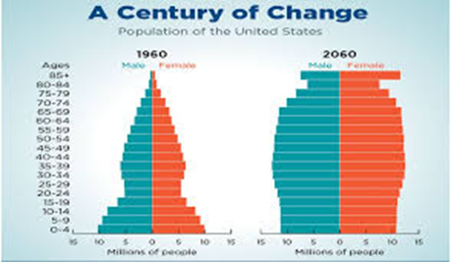
Population ageing has implications for the health of the population and the number of people requiring extended care due to disability or functional limitation is likely to increase in all countries and has important implications for sustainable development

Slide 3
Health systems need to be transformed so that they can ensure affordable access to evidence-based medical interventions that respond to the needs of older people and can help prevent care dependency later in life.

Slide 4
Developing evidence-based interventions for these older people is a public health priority.
Precision recruitment methodologies are needed to improve the efficiency of this process.
Geographic Information Systems (GIS) offer the potential to determine location trends of an older adult population.

Slide 5
One potential approach for exploring the role of context in health promotion and public health research is to incorporate a Geographic Information System (GIS) when examining health questions

Slide 6

GIS(Geographic Information Systems)
A computer-based system used for the integration and analysis of spatial data, which has the ability to generate extensive relational databases
A GIS can be defined as a organized collection of five key components:
i) computer hardware
ii) computer software
iii) geographic (cartographic ) and attribute (other variables)
iv) GIS-trained personnel
v) statistical techniques and methods for data modeling and analysis
(Chung, Yang, & Bell, 2004; Cromley & McLafferty, 2002; T. B. Richards, Croner, & Novick, 1999b, 1999c; G. I. Thrall, 1999)

Slide 7
GIS(Geographic Information Systems)
In this way, a GIS can be used to integrate spatial data, or data that are characterized by location, and related qualitative or quantitative information (e.g., social, economic, health, environmental conditions), which are listed as ‘attributes’ of the spatial location

Slide 8
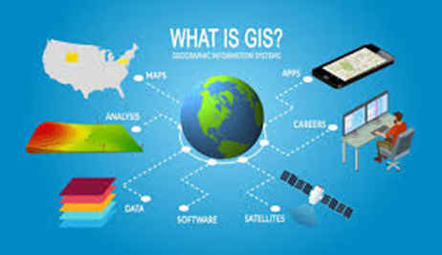
GIS(Geographic Information Systems)
It is a powerful tool that is highly effective at combining disparate data sources to visually illustrate complex relationships within that data

Slide 9
Studies of geographic accessibility have been traditionally focused on individuals’ access to health services in time and space, and may offer valuable insights into health decision making
This information is being used to help reduce health disparities by informing policy
(Fulcher & Kaukinene, 2004)

Slide 10
The final review was comprised of 621 journal articles and book chapters reporting health-related applications of Geographic Information Systems
i) disease surveillance (n = 227); ii) risk analysis (n = 189); iii) health access and planning (n = 138); iv) community health profiling (n = 115); and (v) general/methodological (n=17)

Slide 11
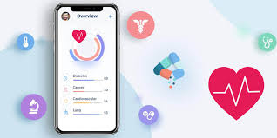
M-Health
Mobile health (mHealth), a term used for healthcare delivery via mobile devices, has gained attention as an innovative technology for better access to healthcare and support for performance of health workers in the global health context.
The proliferation of mobile phones has provided a powerful communication channel to strengthen health information systems.

Slide 12

WHAT IS THE DIFFERENCE BETWEEN
A HEALTH APP AND AN M health?
M Health or mobile health refers to the practice of medicine and public health supported by mobile devices such as mobile phones, tablets, personal digital assistants and wireless infrastructure. It encompasses all applications of telecommunications and multimedia technologies for the delivery of healthcare and health information.
health apps can provide valuable information to users. However, it may be hard to determine the accuracy of the information provided and may not be easy to share this data with the user’s doctor.

Slide 13
when used in conjunction with health care–related software apps, they can also provide real-time feedback needed to monitor treatment compliance or effect, and also serve as data collection tools

Slide 14
Mobile application
Mobile application is a new and fast developing Segment of the global Information and Communication Technology. Mobile application is easy, user friendly, inexpensive, downloadable and run able in most of the mobile phone including inexpensive and entry level phone. The mobile application has wide uses for its vast functioning area like calling, messaging, browsing, chatting, social network communication, audio, video, game etc.

Slide 15
Health Care Services for Low Socioeconomic Populations
Access to Health Care Services for Low Socioeconomic Populations GIS approaches have also been used in studies exploring lower socioeconomic population groups’ access to health care services
for example:
evaluating access to general health care facilities in Buffalo, New York, USA, (Niewczyk & Lwebuga-Mukasa, 2006)
identifying the availability of prenatal clinic services for low-income mothers (McLafferty & Grady, 2004)
methods for using a GIS to explore and visualize distances that working poor families (that have children with disabilities) have to travel to services are described.

Slide 16
In summary
GIS mapping is an effective public health tool for helping to prevent the spread of diseases, facilitating the development of interventions, evaluating health outcomes, appraising population risks, and for summarizing and displaying health indicators.
Opportunities for collaboration between disciplines such as geography and health should be maximized for the mutual benefit of researchers, practitioners, decision makers, and communities.

Slide 17
Thank you for attention
Any question?

