Slide 1


Slide 2


Effectiveness of Smart Phone Using on Improving Technophobia
4th Shiraz International Congress on Mobile Health
Dr Mahin Nazari
Department of Health Education and Promotion,
Shiraz University of Medical Sciences

Slide 3
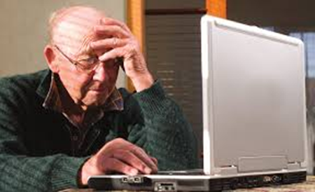
What is technophobia?
fear or dislike of modern technologies and complex technical devices or discomfort with them.
This fear is related to an irrational fear of computers, robots, artificial intelligence, weapons, and other such objects that seem advanced in scientific thought .

Slide 4
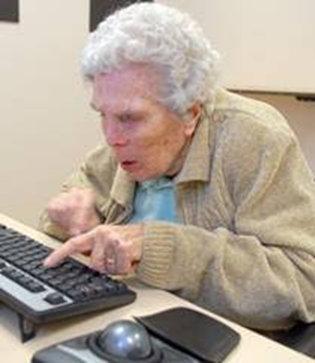
Technophobia in the elderly:
In one poll, only 18% of older adults claimed that they would feel comfortable learning to use a new device (i.e. tablet or Smartphone) on their own.
Professor Peter Hall: “There was a strong association between age and confidence—confidence about technology use really dropped off in the oldest age groups,"
Older adults may also have skeptical attitudes about the benefits of technology. Difficulties in learning new technologies may also preclude the use of new technology.

Slide 5

Digital skills are now as vital as literacy, and the world needs digitally competent people who are able to not only use but also innovate and lead in using these technologies

Slide 6
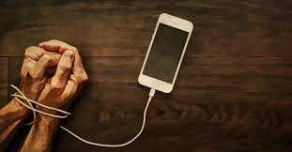
People who feel intimidated by these objects are more likely to experience technology anxiety, and frequently, the non-tech savvy older population faces a risk of lowered quality of life and chances of inclusion

Slide 7

The ability of older adults to use digital solutions and tools is a crucial issue, because low adaptation to the digital era is a barrier in daily living that reduces quality of life, independence, autonomy, and mental health; additionally, such tools could effectively enhance medical care in older adults

Slide 8
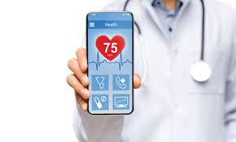
Fear of technology is prevalent among older generations who deal with computers, complicated acronyms, or digital games; however, such fear is not seen in the case of mobile phone use, which has been attributed to socioeconomic success

Slide 9
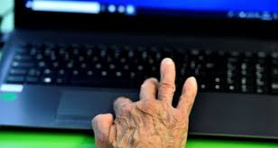
Benefits of using technology by the elderly
helpful in maintaining older adults’ independence,
social connectedness,
sense of worth in the face of declining health or limited capabilities,

Slide 10
Benefits of using technology by the elderly
offer them better quality of life and new opportunities for personal growth
offer older adults a wide variety of practical, physical, social, and psychological benefits
assist in maintaining relationships with family and friends as well as for making new friends

Slide 11

Technology creation, adaptation and its use by older people in health care are becoming increasingly Aimportant in our society

Slide 12
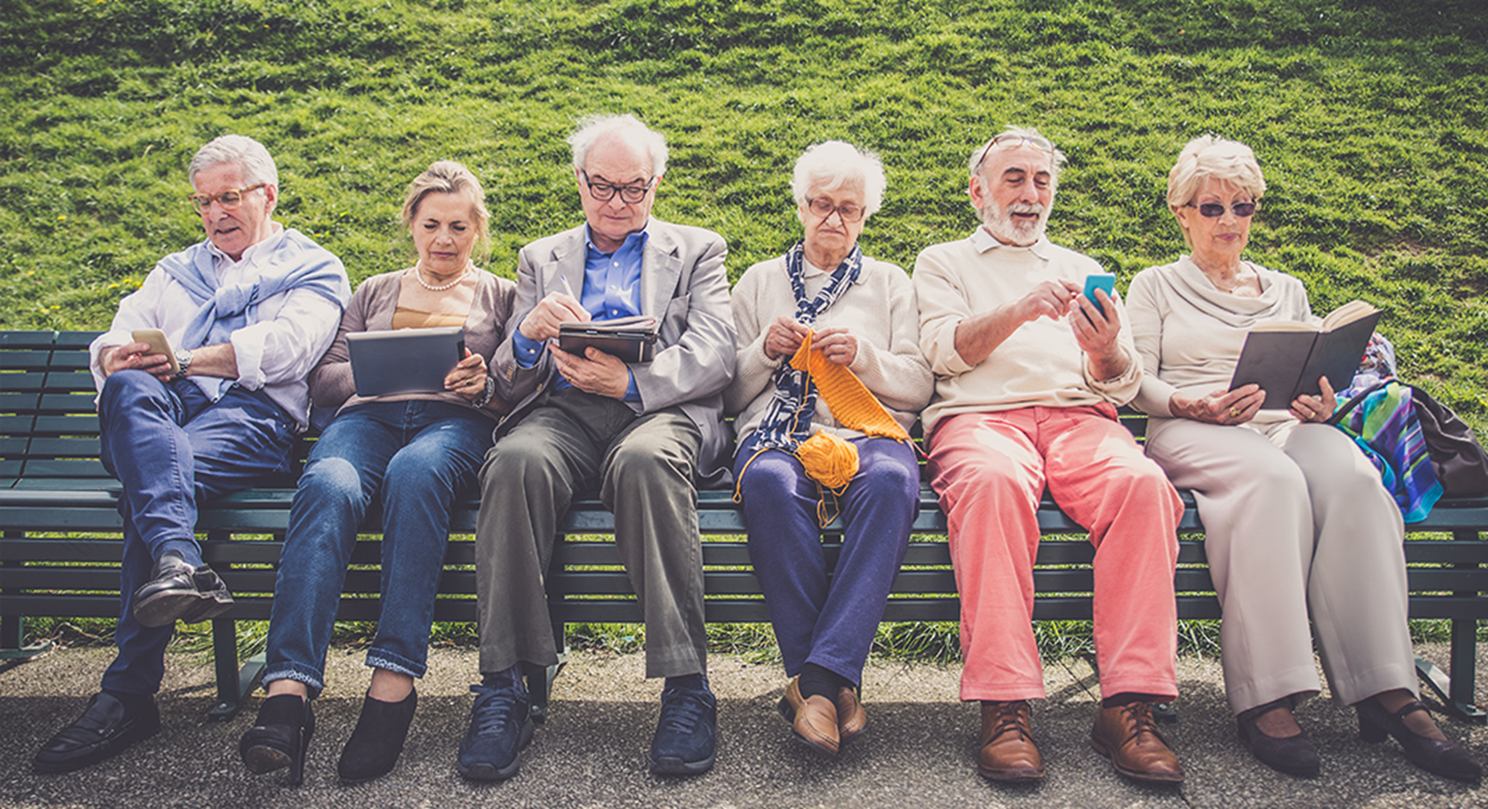
Smartphone Uses:
independence in activities of daily living (ADLs),
instrumental activities of daily living (IADLs),
rest and sleep,
education,
work,
play,
leisure and social participation

Slide 13
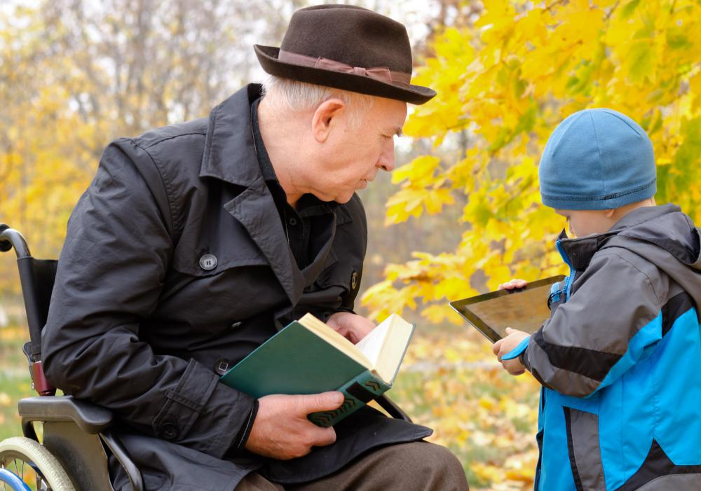
Ways to reduce technophobia
Assess the attitudes of end users, then place them in appropriate learning groups.
Learn new technology from someone who's skilled in using it and can explain it without jargon.
Make sure that technology instruction is hands-on for all users.
New technology is best learned together, using a sequence of skills geared to the new user's knowledge level and attitude.
Don't move into new instruction areas until current information is clearly understood and mastered.
Use the identical version of the new user's hardware and software programs for training.

Slide 14

Thanks for your attention

