Slide 3
Title
Virtual Care for Older Adults in the Post Corona Era: Experience of a Governmental Organization

Slide 7
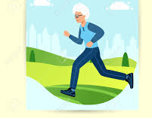
Shiraz Farzanegan Foundation
Currently receives 12989 elderly members from all over Shiraz. And now about 2953people are waiting in line to join the foundation, which we could not accept due to limited space and facilities.

Slide 9
Importance of continuing to provide services to the elderly during corona disease
Advice on COVID-19 for older people and caregivers
Self-care for the general well-being of older people
Use of information and communications technology
Advice for self-management post COVID-19 infection
Manage activities of daily living
Manage stress and problems with mood
Manage problems with attention, memory and thinking clearly

Slide 15
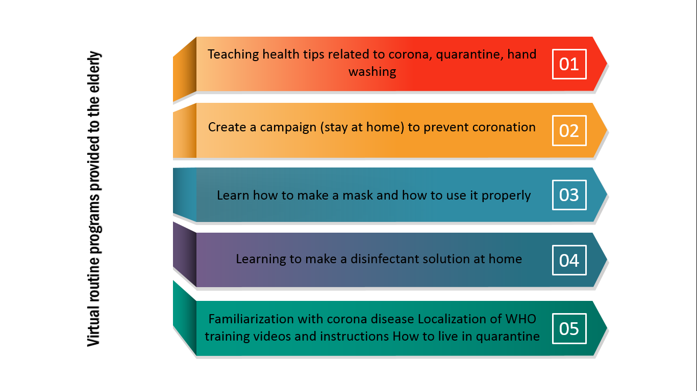

Slide 16
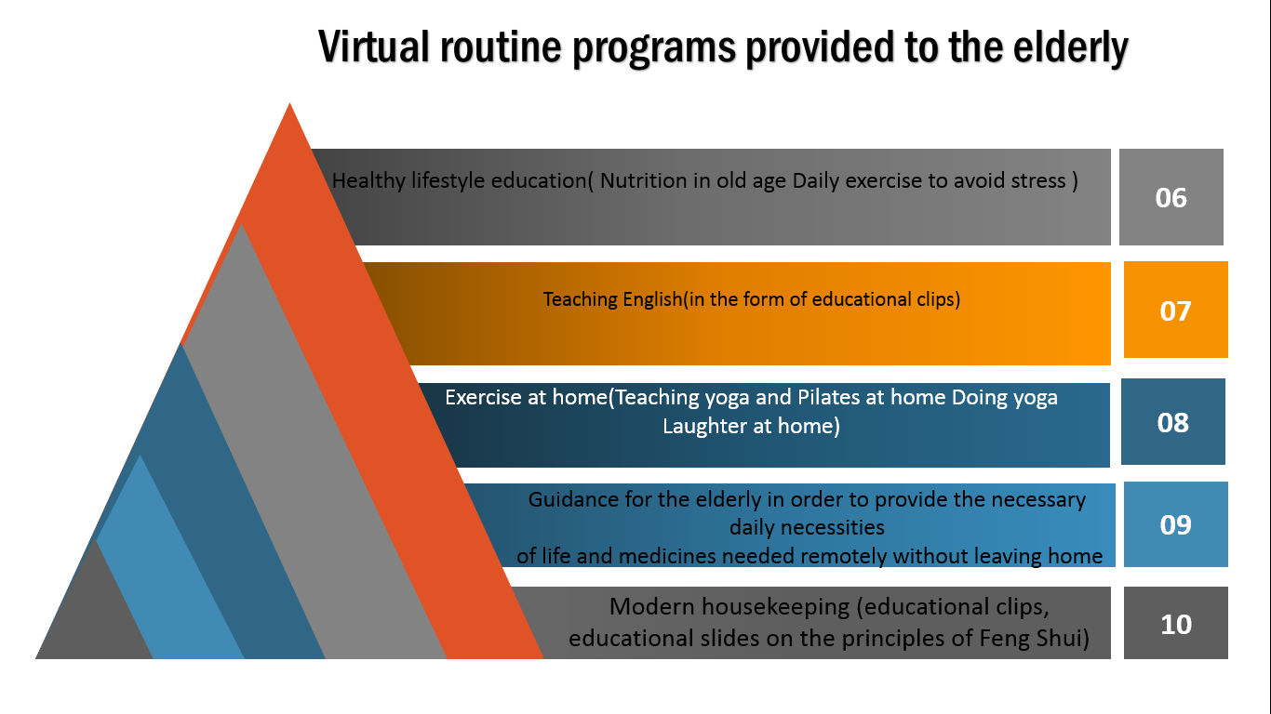

Slide 19
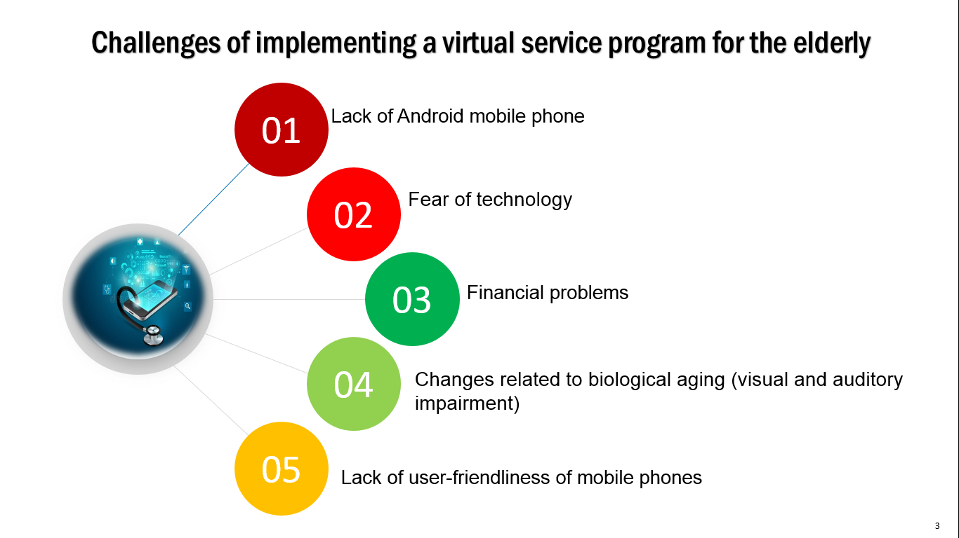

Slide 21
Thank You For Attention

