Slide 1



Opportunities and Challenges of Mobile Health Education in Aging Society
School of Health
Masoud Karimi
MD, MPH, PhD in Health promotion
Assistant Professor
Shiraz University of Medical Sciences
karimeim@sums.ac.ir

Slide 2
Technological innovations
Bridge health disparities
Meet unmet needs
  of populations.

Slide 3
Demographic trends (population ageing)
+
Growth of using mobile phone among the older adults
Mobile phone as a platform for health interventions
overcome social exclusion (loneliness)
expanding access to information
enhancing autonomy and self‑care
improving their quality of life through social participation

Slide 4

Mobile learning
Involves the use of mobile technology, either alone or in combination with other information and communication technology (ICT), to enable learning anytime and anywhere.

Slide 5

Benefits of Mhealth Learning
Expand the reach and equity of health education
Facilitate personalized learning
Enable anytime, anywhere learning
Build new communities of learners
Support situated learning
Assist learners with disabilities
Maximize cost-efficiency
Mobile phones provide a new communication channel for health promotion
for example:
To increase participation in immunization campaigns
To promote voluntary counselling
Notes:
Situated learning is an instructional approach developed by Jean Lave and Etienne Wenger in the early 1990s, and follows the work of Dewey, Vygotsky, and others (Clancey, 1995) who claim that students are more inclined to learn by actively participating in the learning experience. Situated learning essentially is a matter of creating meaning from the real activities of daily living (Stein, 1998, para. 2) where learning occurs relative to the teaching environment. The following are examples of situated learning activities: field trip, Cooperative education and internship experiences ; Laboratories

Slide 6
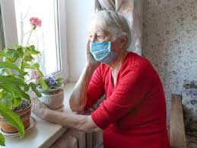

Health education for elders in Covid-19 pandemic

Slide 7
Although seniors consistently have lower rates of technology adoption than the general public, this group is more digitally connected than ever.

Slide 8
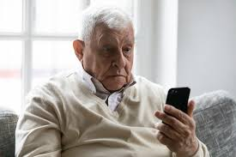

Stereotypes
Older adults are afraid, unwilling, and unable to use technology, including mobile phones
Conci et al.:
  in the elderly, once the initial resistance of learning new technology was overcome‑ “enjoying the experience” of using the mobile phone motivated them to use the device.

Slide 9
Aging and Perception
Physical Factors That Affect Perception
  Visual and aural presentation
    Slower adaptation when light levels are rapidly changed
    Divided attention (multitasking)
    Selective attention (filter out unimportant from important information )

Slide 10
Aging and Perception
Cognitive aging factors that affect language processing
    Loss of processing speed
    Reduced processing space
    Reduced processing efficiency
  102 and 120 wpm
  short sentences with one simple idea per sentence
  Reducing volume of information

Slide 11
Aging and Perception
Cognitive aging factors that affect memory
  Memory allows:
    The storage of information
    More complex functions such as:
      Estimation
      Comprehension
      Decision making
      Inferencing
      Observational learning
      Problem solving
  Delivering information in small chunks
  Relating new information to old yields

Slide 12
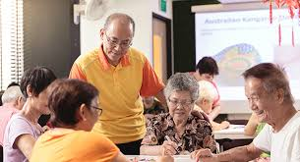
Andragogy
Principles:
  Active Learning:
      Active participation through discussion, feedback and activities instead of passive listening or reading.
  Problem-Centric:
      Adults are problem-centric, not content-centric
      Adults come to your presentation expecting to get their problems solved not to get more information.
  Previous Experience
  Relevance:
      Content must have meaning and immediate relevance (what’s in it for me)

Slide 13
Andragogy
Principles:
  Self-Learning:
      Adult learners have some strong beliefs about how they learn. so, let them decide how learn it. (Provide them with options)
  Fun:
      Learning should be fun. make learning fun, enjoyable and filled with laughter!
  The depth of adults learning depends on the depth of their engagement.
  Repetition increases retention of critical information.
      Short-term memory decreases with age. The more critical learning points need to be repeated in a variety of ways

Slide 14
Adult learners characteristics
Non homogenous group:
  Age variation
  Previous education experiences
  Self-directing or dependent learners

Slide 15
Andragogical Practice
Knowles (1984)
Facilitators must:
  Involve learners in mutual planning of methods and curricular directions
  Involve participants in diagnosing their own learning needs.
  Encourage learners to formulate their own learning objectives.
  Help learners to carry out their learning plans
  Involve learners in evaluating their learning

Slide 16
Three learning domains
Printed materials
Lecture
Audio
Visuals
video
Visiting the field
Explanatory methods
Role play
group discussion
Movies and videos
Explanatory methods
Demonstration
Drills
Role play
Video tapes and videos

Slide 17
Thank you
for
your attention

