Slide 1
nutritional applications growing trend
Dr Masoumi
Md, Mph, clinical Nutritionist

Slide 2
The number of mobile phone subscriptions by the end of 2015 almost equalled the world population of seven billion people
Today’s children are growing up in a quickly changing digital age that is much different from that of their parents and grandparents.

Slide 3
mobile phone technology plays a large role in our daily lives, from communications to commerce, health workers and community

Slide 4
World Health Organization (WHO) defines mobile health, m-health, as the medical and public health practice supported by mobile devices, such as mobile phones, patient monitoring devices, personal digital assistants (PDAs), and other wireless devices

Slide 5
MHealth facilitates providing health services, speeds up the process, and reduces the costs and complications of direct services
MHealth can be used in epidemic and pandemic outbreaks because of its accessibility, ease of use, and attracting many users

Slide 6
Mobile devices provide new options for facilitating: disease prevention and management and advancing health monitoring and assessment.
mHealth are viewed as an attractive approach to foster behavior change, and found to be effective in promoting physical activity and healthy diets
The use of mobile devices in the nutrition field has grown rapidly in line with digital technology developments.

Slide 7
Mobile tools have the potential to enhance flexibility and efficiency to improve dietary and health-related behaviors, and to enable efficient communication between caregivers and their care recipients.
Mobile devices hold promise for tracking and assessing individual's diet and collecting large chronological data on dietary information.

Slide 9
mHealth Apps Market Size
The global mHealth apps market size was valued at USD 40.05 billion in 2020 and is expected to grow at a compound annual growth rate (CAGR) of 17.7% from 2021 to 2028.

Slide 10
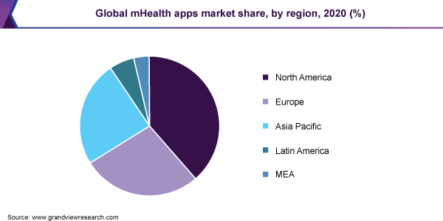

Slide 11
the market and growth nutritional apps statistics
these apps have seen an increase in their engagement of over 330 percent.
A Grand View Research clarifies that the global mobile health market will grow at a CAGR of 29.2 percent.
it is believed that the market will reach $ 316.8 billion by 2027.

Slide 12
the market and growth nutritional apps statistics
Which age group has the maximum usage of these apps?
Statista reports that people between 18 to 29 use these apps on a regular basis to track their diet.
53 percent of the people use these apps to track their physical activities, 48 percent use it for tracking their food habits, 47 percent to lose weight, and 37 percent to learn exercise.

Slide 13
The global fitness app market size
The global fitness app market size was valued at USD 4.4 billion in 2020 and is expected to expand at a compound annual growth rate (CAGR) of 21.6% from 2021 to 2028.
the COVID-19 pandemic lockdown has led to a transition to virtual fitness from traditional studios and gyms and increased the downloads and usage of fitness apps.
According to an article published in the World Economic Forum in September 2020, the global downloads of fitness and health apps increased by 46%.

Slide 14
Opportunity
Threat

Slide 15
Conclusion
Opportunity
Threat

