Slide 2
Virtual hospital in COVID-19 pandemic: pros and cons
Najmeh Maharlouei; MD
Saeid Shahabi; PhD
Kamran B Lankarani; MD

Slide 3
introduction
As a global pandemic, COVID-19 has posed a number of challenges to health care systems.
high transmissibility and lack of effective treatment has led to a case fatality rate more than 1% worldwide.

Slide 4
https://www.worldometers.info/ coronavirus/country/iran/

Slide 5
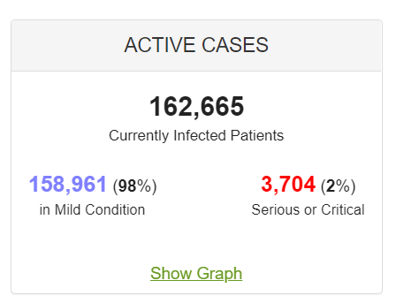
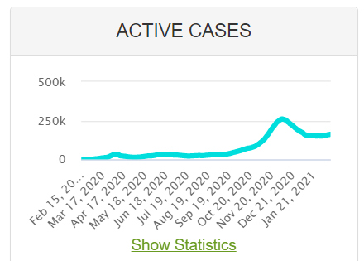
https://www.worldometers.info/ coronavirus/country/iran/

Slide 6
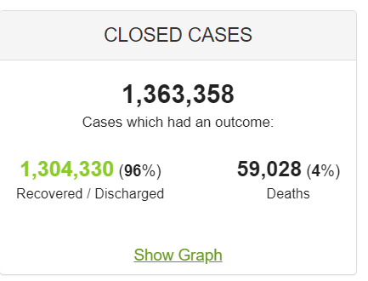
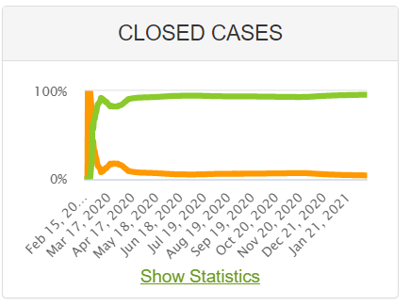
https://www.worldometers.info/ coronavirus/country/iran/

Slide 7
introduction
increasing demand for health services, especially inpatient cares, has put significant strain on hospitals and health care workers, which can affect the quality of the services.
Due to this situation, the hospitals and medical centers have filled to capacity in Iran.
Therefore, moving towards innovative strategies such as virtual care services can be vital in reducing the strain on medical centers and increasing the capacity of hospital beds during pandemics such as COVID-19.

Slide 8
introduction
The application of hospital at home model to provide sub-acute and acute health care services has been more sought in recent years, which of course has had desirable consequences.
Atrium Health, a health care system in the southeastern United States, has created a virtual hospital program to provide health care services to more than two thirds of the covered population during COVID-19 outbreak

Slide 9
introduction
Following this program, home monitoring services as well as hospital-level care are provided through virtual units called virtual observation units and virtual acute care units for eligible patients, especially COVID-19 patients.
The findings show that development of a virtual hospital can be an effective strategy to increase the capacity of hospitals following the rapid expansion of COVID-19

Slide 10
introduction
In addition to all the benefits of virtual hospital, there are serious challenges in the planning and implementing process of that, especially in developing countries such as Iran.

Slide 11
Benefits of virtual hospital
Increasing the capacity of hospitals
restricting exposure to other patients and health care workers
Reducing the need for protective equipment following reducing the risk of exposure
reducing the stress level of patients
empowering the patient's family to provide informal care services

Slide 12
Benefits of virtual hospital
Reducing the cost of treatment of patients
improving the access of patients in deprived and remote areas to high-quality services as well as relevant specialists
preparing instant and online data about COVID-19 pandemic for effective planning and policy-making

Slide 13
Challenges of virtual hospital
the need for comprehensive electronic health and medical records
Equity, because access to stable high-speed Internet, as well as laptops and smart phones is not possible in many deprived and remote areas of Iran
lack of literate people aware of the use of instruments such as pulse oximeter, thermometer, and blood pressure cuff in the patient's home

Slide 14
Challenges of virtual hospital
supplying and preparing many such measurement instruments
the need for motivated medical staff (especially nurses) in order to continuously monitor the patients via internet
the need to organize mobile treatment teams to provide needed interventions to patients in their homes

Slide 15
Challenges of virtual hospital
lack of high speed internet infrastructures
the need for appropriate payment and compensation systems in order to motivate service providers
the tendency of Iranians to refer directly to relevant specialists
unwillingness of healthcare providers to visit the patients at home and even make a phone call

Slide 16
Challenges of virtual hospital
lack of high-quality hardware and software in Iran
restrictions on video communications due to ethnic and religious issues in some areas
the need to develop medical ethics guidelines
the need for cyber security for providers and users

Slide 17
Virtual hospital for treating patients with COVID-19
What we need:
Determining where the patients could be screened and selected for referring to virtual hospital
Trained staff
Electronic prescription
Easy access to hospital and equipment
Determination of the number of doctors and nurses based on the patients number and condition

Slide 18
Virtual hospital for treating patients with COVID-19
What we need:
Determination of number of visits per day based on the patients’ condition
Classification of the patients based on their SES, condition and the family support
Training the staff
Advocacy (university, insurance company, beneficent)
5. Payment
6. Monitoring

Slide 19
Virtual hospital for treating patients with COVID-19
Necessities for development of the software
Classifications of the patients based on the severity of diseases
SMS service
Output (graphs, SPSS, Excel)
Different accessibilities based on the role of the staff
Editing the data (record edited was done by who, and when)
The information should be printable for cases need to be referred to hospital or other centers

Slide 20
Virtual hospital
Inclusion criteria for the patients:
All definite case (PCR +ve)
Suspicious cases (based on the guideline)
Exclusion Criteria:
The patients who do not agree
Those who need intubation
Those who have no supportive family
Those who are classified as outpatient

Slide 21
Virtual hospital components
Tabs:
1st: consent form
2nd: demographic information
3rd: vital signs
4th: History (for determining the patients who are high risk)
5th tab: symptoms

Slide 22
Virtual hospital components
Classification of the patients based on the information
Refer to hospital (eg: SO2 < 88%, Shock state, need for intubation)
Sever respirator disease
Moderate respiratory disease
Mild respiratory disease
Could be considered as outpatient

Slide 23
Virtual hospital components
In those who are admitted in virtual hospital following measures should be considered:
Diagnostic measures (PCR)
Lab tests (CBC, PT, PTT, INR, ESR, CRP, BS, Na, BUN ,Cr, TBS, MG, Ca, P, Troponin
Imaging (CXR, CT)
Treatment: primary, secondary and tertiary
Follow up: O2 sat, vital signs, reminding the patients regarding taking the medications

Slide 24
Thanks for your attention

