Slide 1
E-health business models: A quick summary
Mojtaba Hosseini

Slide 2
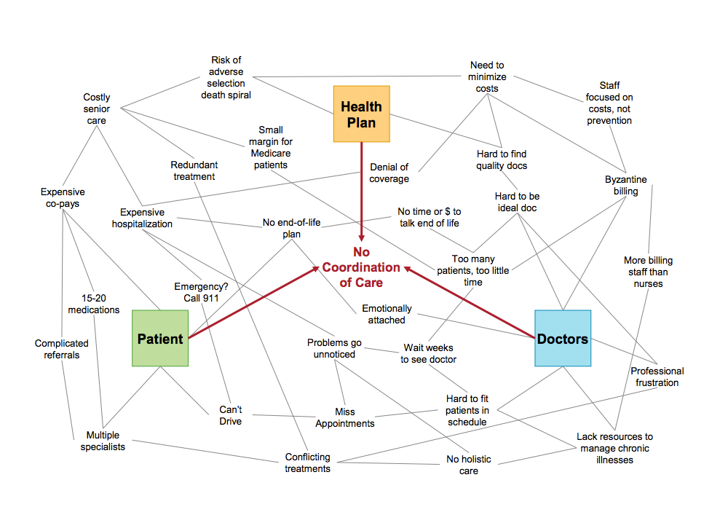
Introduction
Challenges of healthcare
Providing high quality healthcare services while reducing the cost
Collateral Effects: Aging populations, lack of qualified health workers, increased mobility of patients and higher expectations and demands
The healthcare industry rate of IT adoption is low, a big potential for improvement, so, a big expectation exist that e-health could solve some of the problems.
Note #1
Note #2
Many e-health projects fail, but those that succeed generate value for patients and sustainable profits for customers.
So, the question is what are the sustainable business models for e-health? How we can identify them and what are their unique patten and characteristics?

Slide 3
Definitions
E-health and business model
E-health
Business Model
a broad range of medical informatics applications for facilitating the management and delivery of healthcare (Pagliari et al 2005).
Not only a technical development, but also a state-of-mind, a way of thinking, an attitude, and a commitment for networked, global thinking, to improve health care locally, regionally, and worldwide by using information and communication technology’’ (Eysenbach, 2001)
A business model depicts an organization’s value creation, proposition, and capturing (McGrath 2010). A business model can be understood as a mediating construct between IS/IT and economic value (Chesbrough and Rosenbloom 2002).
What is?
ITALY
What is?
PARIS

Slide 4
Importance
E-health business that survived, showed a good balance between value proposition and sustainable profits.
Of Business Models
Design of the business model is a great matter for e-health start-ups:
while we found that a considerable effort was put into the development and deployment of an IS/IT infrastructure, we saw that the business perspective was neglected. This can be dangerous, as similar situations like the burst of the ‘‘dot.com’’-bubble in the late 1990 s demonstrated.
Using a well-studied and well-established business models is a way to fill the gap.
Note #1
Note #2
The higher the level of technological initiatives need a more clear business models to work.
e-health solutions focusing on efficiency instead of value for the patient

Slide 5
E-health
Business Types
#1
#2
Personalized Health Solutions
Data on Request
Consumers expect health care services customized to suit their needs, health history & scores of other personal attributes.
Appropriate access to health knowledge is vital for the management of individual health.
PHC
TLH
DOR
#3
#4
Patient Experience
Care-anywhere networks
Health systems are beginning to embrace more patient–centric metrics of care, by focusing on treatment outcomes.
Technology will reduce the utilization of hospitals, nursing homes, and physician office visits. Wherever they go, the care network shall follow!
CAN
PEX
#5
Telehealth
Through collaboration and investment, a grid of technicians, clinicians, hospitals & doctors would be able to offer consultations remotely.

Slide 6
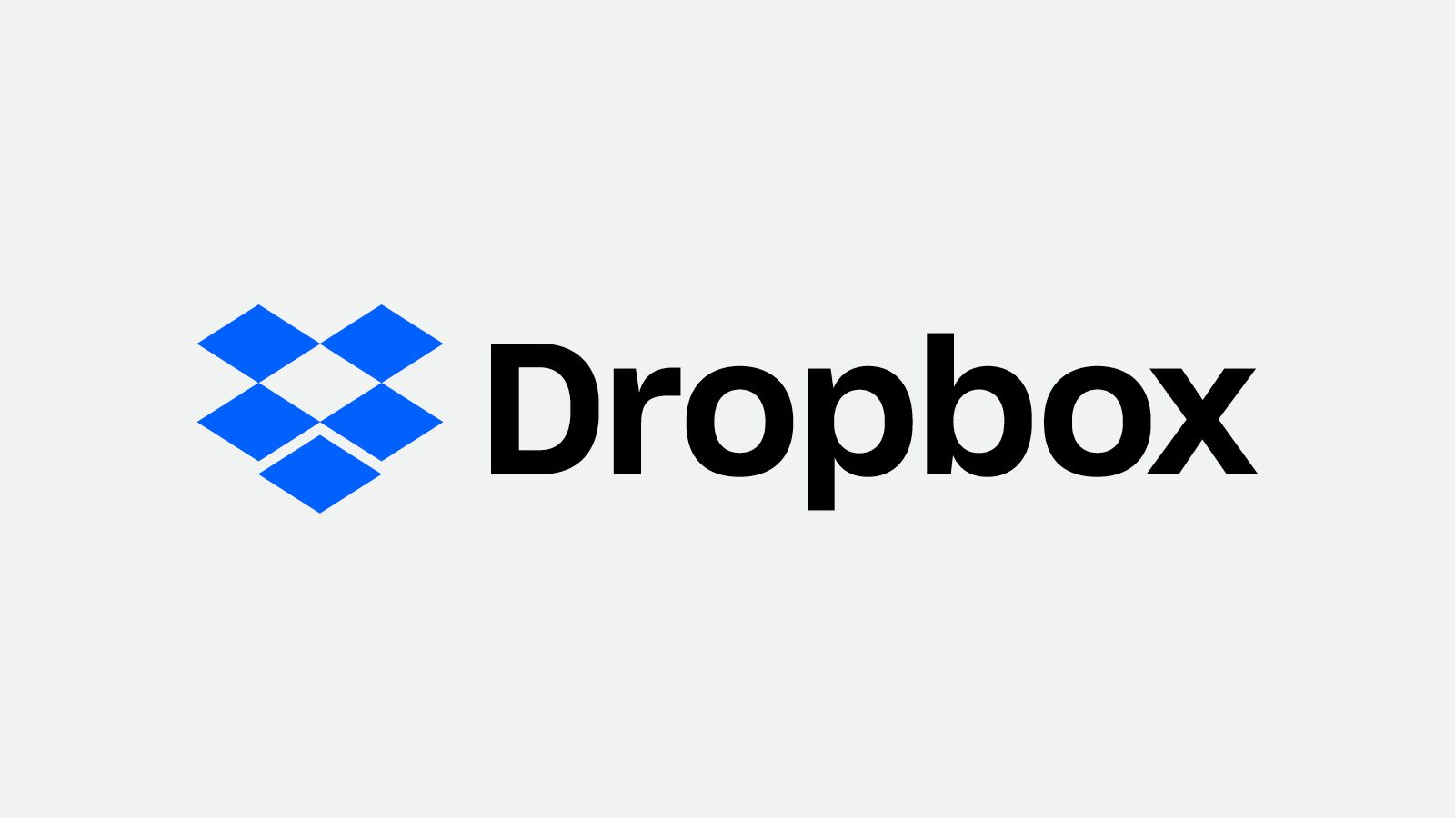
BM #1
Fermium BM
Basic services are offered for free, while a premium is charged for an advanced service
Using certified health information and professional layout create credibility, but how do you persuade potential users to use the service
The more valuable the service becomes for all consumers; and the greater the network, the higher the lock-in effect gets, and costs and efforts increase to change to a competitive service
A major difficulty is to keep the balance between free and premium users, since the latter sponsor the former

Slide 7
BM #2
Multi-sided BM
The value creation is based on the interaction among parties
This design pattern basically comes in to use when one party has a considerable interest that another party is given subsidized or easier access to a service
Typically, the service to be delivered is either very complex from a technical point of view or there is a lack of trust when it is provided by the interested party on its own.
Being a kind of ‘‘platform’’ for all sorts of services, the broker has the crucial task of balancing the subsidies and revenues from multiple parties in order to ensure both a large customer base (who trust the broker) and a high quantity and quality of services.

Slide 8
BM #3
Crowd Sourcing/Open BM
Commitment of motivated individuals produce value for the organization for free
Possible solutions are crowd-based concepts such as crowd sourcing, crowd creation, crowd voting, or crowd funding .
The basic idea behind the crowed-based business logic is to use the creativity, knowledge, leisure, or money of dozens,
e-health services that rely on crowd-based concepts are risky as they have a high dependency on altruistic user behavior.

Slide 9
BM #5
Razor and Blades BM
A customer is lured with a special deal and by relying on lock-in effects profit is made from sales of complementary goods
Sell as many "razors" as possible in order to generate an increasing stream of recurring income from "blade" sales over the life of the "razor."
Razor-and-blade business models can be lucrative when they're working well, but they can stumble when competitors enter the market with a compelling "razor" that uses less-expensive "blades"

Slide 10
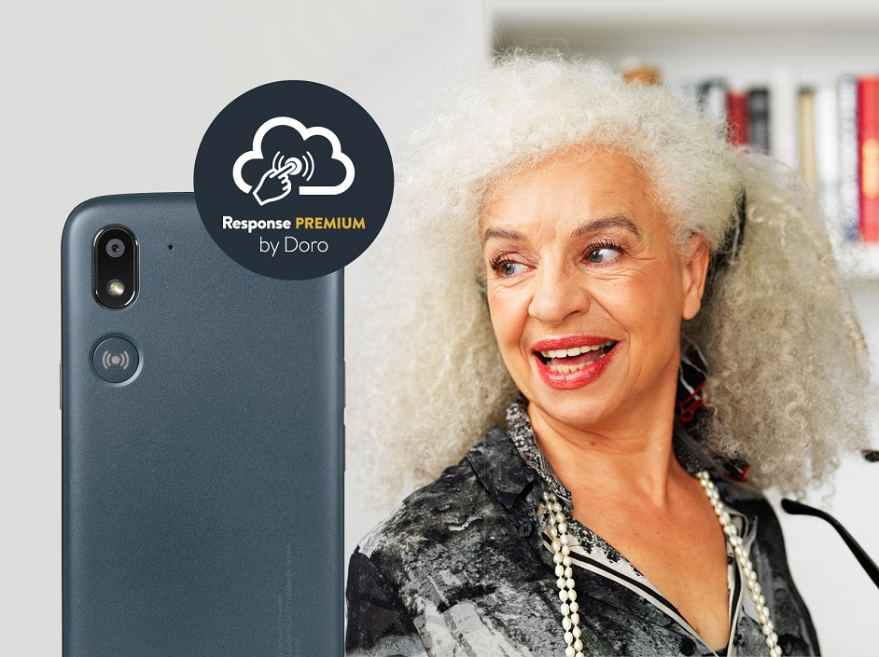
BM #6
Inverted Razor and Blades BM
Complementary goods attract the customer and make her buy the core product
This kind of business model seems work great when company target a tiny part of the market who have especial need and ready to pay more
Challenge here is to justify customer to pay more at first for the razor.

Slide 11
BM #7
As a Service BM
Only the usage of service is charged but not the product itself
A business model that allows customers to purchase a desired result rather than the equipment that delivers that result.
you don’t sell the product itself but charge for the usage or the output of the product, such as pay-per-use or a monthly flat fee, like Uber or Netflix, respectively
Challenges in this BM are: Avoid downtimes, Improve service efficiency, Performance financing approach, and Positive user experience

Slide 12
Final conclusion ...
Goal of the business | Suitable BM | Challenges
Personalized Health Solutions | Fermium BM | Keep balance between free and premium features
Data on Request | As a Service | Downtime, service efficiency, performance financial approach, and positive customer experience.
Patient Experience | Crowd Sourcing/Open BM | Risk of high dependence on altruistic user behavior
Care-anywhere networks | Razor and Blades BM | stumble when competitors enter the market
 | Razor and Blades BM | Persuade customer to pay high up-front premium
Telehealth | Multi-sided | Multi-sidedbalancing high customer base and high quantity and quality of businesses
Conclusion
Type-BM matching
Seems some BMs work better for specific e-health business types and function. Entrepreneurs should mix their experience and what the literature recommend to select the best BM which works better for them.
Some companies mix two business models which they need to handle all the challenges.

Slide 13
THANK YOU!
FOR YOUR ATTENTION

