Slide 1
Lessons learned in Pakistan: mhealth and Covid-19
DR. Nadeem Mahmood
Chairman & Associate Professor
Department of Computer Science
University of Karachi
Email: nmahmood@uok.edu.pk

Slide 2
Agenda
University of Karachi/UBIT Introduction
Pakistan Demographic and Health Sector Data
Covid-19 Pakistan Statistics
mhealth Applications in Covid-19
Lesson Learned (Barriers, Opportunities and Way forward)

Slide 3
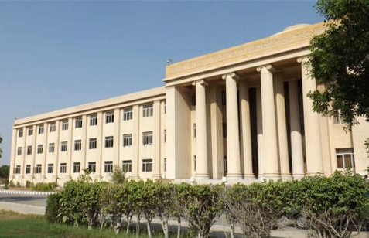

Slide 4
Pakistan Demographic and Health Sector Data

Slide 5
Health Sector of Pakistan
Pakistan is a large country with an area of 796,100 kilometers and an estimated population of 200 million making it the fifth most populous country in the world.
In Pakistan, 72% of the population lives in rural areas and 28% of the population lives in urban areas. A consistently high population growth rate exceeding 2% annually has led to Pakistan being quite a young nation with over 35% of its population being under the age of 14 years.

Slide 6
Continue..
According to recent statistics.
Pakistan has 95,000 nurses and 180,000 doctors.
Pakistan has approximately 14,000 health institutions in the country including 1000 hospitals, 105,000 hospital beds, 4,800 dispensaries, 5,500 basic health units, 900 mother and childcare centers and 600 rural health centers.
It is noteworthy that Pakistan is the fourth highest source of international medical graduate doctors in the United States.

Slide 7
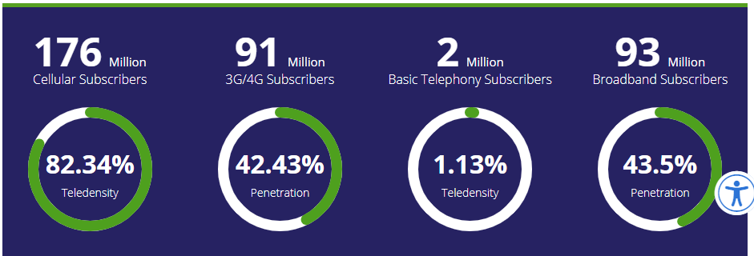
Pakistan Telecommunication Authority: Mobile Users

Slide 8
Covid-19 Pakistan Statistics

Slide 9
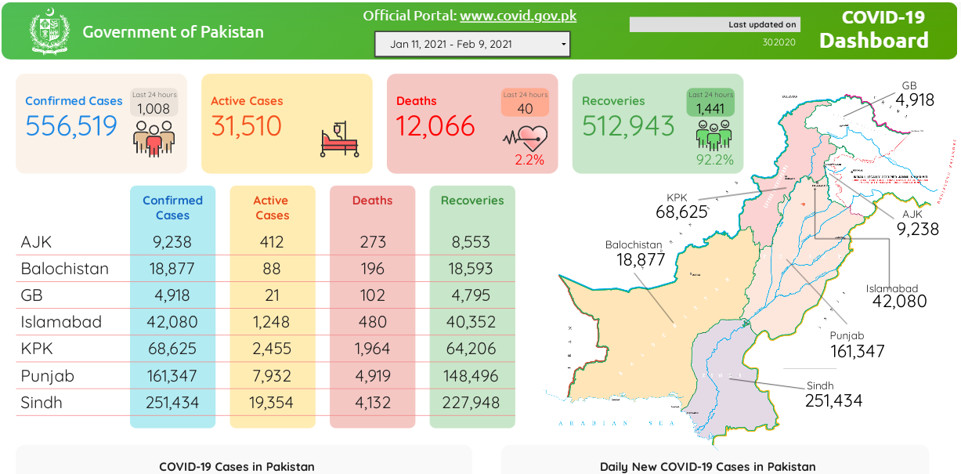

Slide 10
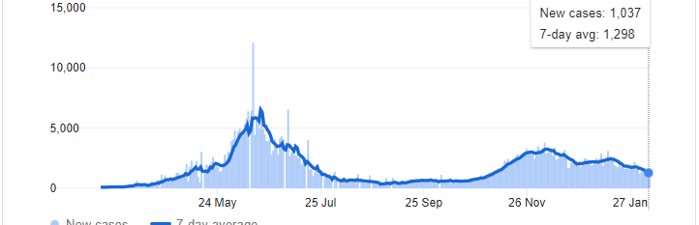
Daily Change : New Cases

Slide 11
Covod-19 Graphic Representation (1)
Overview
Daily Tests & New Cases Distribution

Slide 12
Covod-19 Graphic Representation (2)
Covid-19: New Cases vs. Newly Recovered in Pakistan
Covid-19: Daily Test Conducted

Slide 13
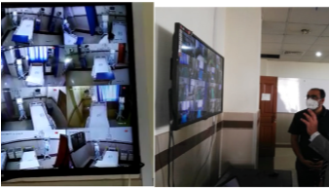
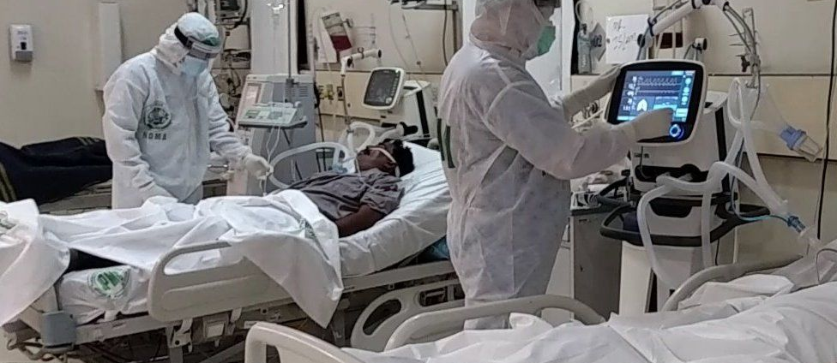
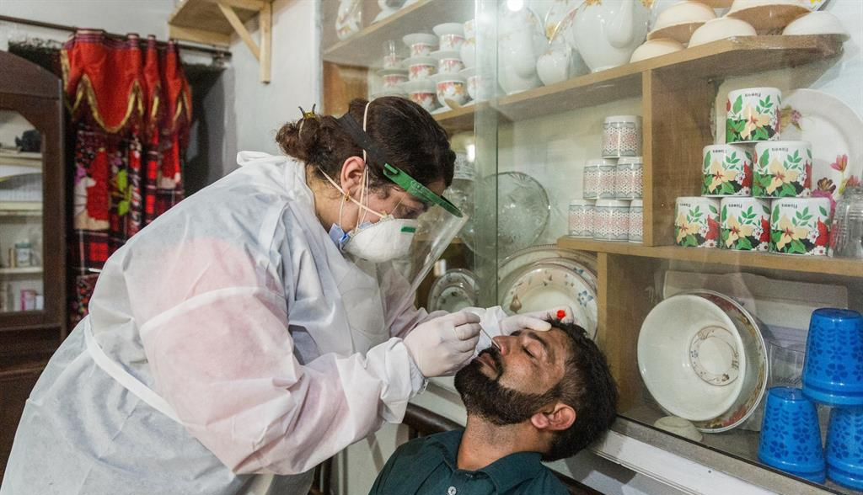

Slide 14
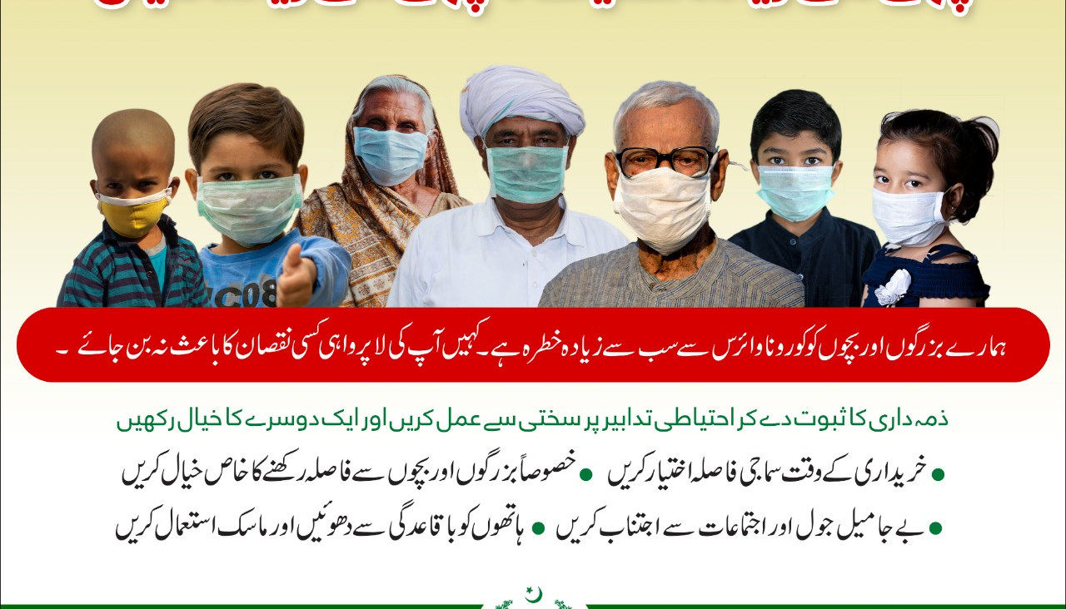

Slide 15
mhealth Applications in Covid-19

Slide 16
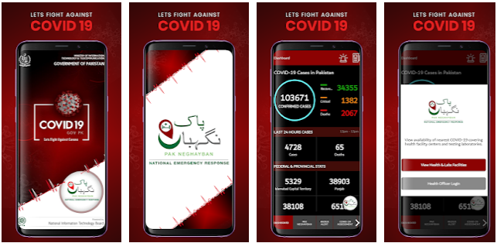
COVID-19 Gov PK (Official Mobile Application)

Slide 17
CoronaCheck
a new mobile application that allows users to conduct self-assessments at home while raising awareness of measures to prevent COVID-19, has been launched today by the Aga Khan University Hospital (AKUH). The self-assessment tool – an interactive chatbot, driven by Artificial Intelligence (AI) -- allows users to understand their symptoms, recognise whether they may have contracted COVID-19 and seek help in a timely manner.

Slide 18
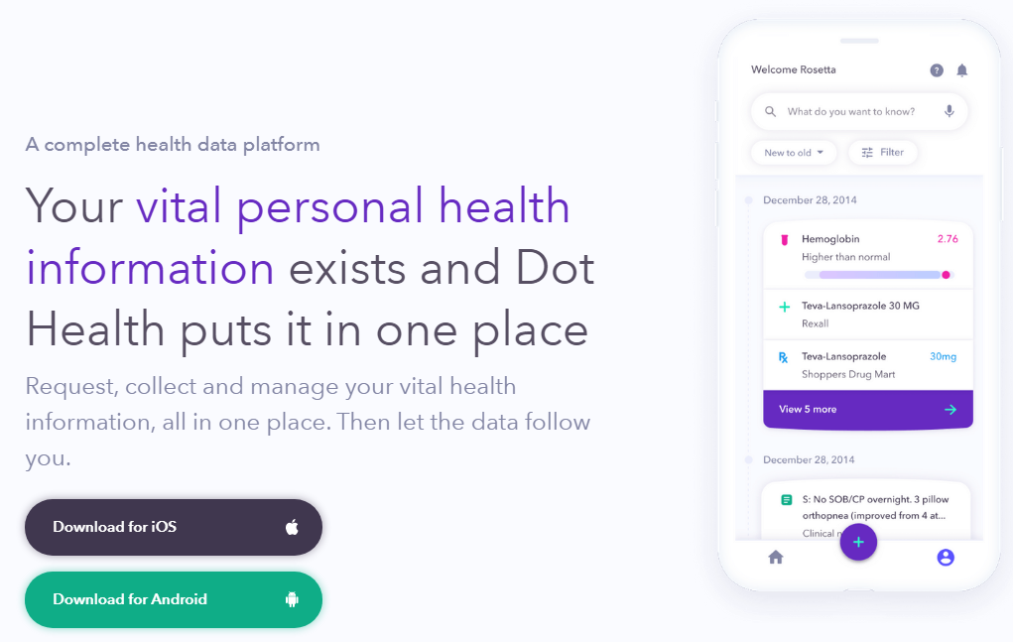
https://www.dothealth.ca/

Slide 19
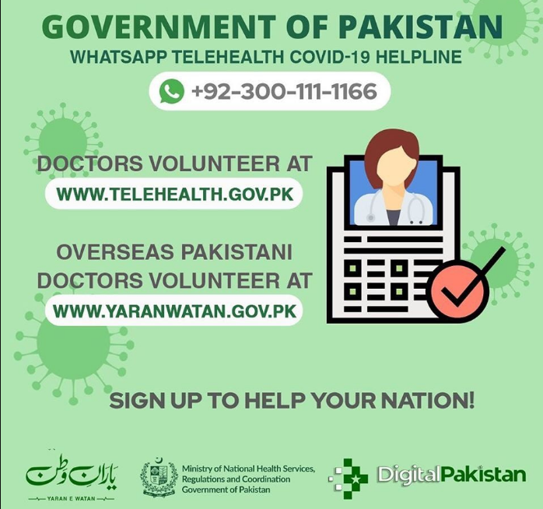

Slide 20
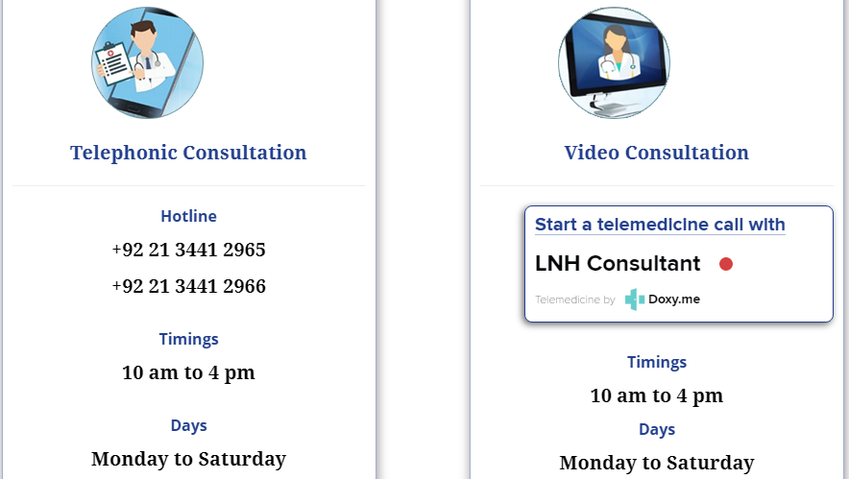
Telehealth for Coronavirus (COVID-19) Liaquat National Hospital Karachi

Slide 21
Lesson Learned (Barriers, Opportunities and Way forward)

Slide 22
Lessons Learned
The learning curve for COVID-19 is steep; relying on data and evidence-based policy making is paramount to saving lives
Decisions must be based on an ‘integrated framework’ of top-down and bottom-up policymaking
Invest in the neglected public health sector through sustainable programmes
Public engagement through effective government messaging is instrumental
Adopt disaster preparedness and build resilience across the entire governance structure
Develop reliable health data integrated system and invest in health information technology infrastructure

Slide 23
Health IT: The best solution
Health IT can play a crucial role in the collecting and reporting of COVID-19 data. Electronic health information exchange can facilitate effective strategies to combat COVID-19:
Surveillance
Public health reporting
Laboratory testing
Clinical data collection
Case investigation and management
Reporting outcomes
Workforce Safety and Health

Slide 24
Barriers in implementing the mhealth and ehealth applications:
Patentability;
little deployment of mHealth apps and new digital tools in
current clinical practices;
Trust deficit
communication gap between multiple stakeholders
Lack of evidence on the validations of digital health devices
and smartphone apps;
Unavailability of regulatory frameworks.
Lack of IT oriented trained Health professionals.
Limited functionality for natural language processing for
local languages in mhealth applications.
Connectivity/bandwidth limitations in the rural areas.

Slide 25
Way Forward: Recommendations
Health information system integration
Health profile of every citizen National Health Card (like CNIC)
Establishment of Emergency response units for health emergencies
Information sharing and dissemination to masses
Regulatory framework for mhealth and ehealth applications
Real time Disease surveillance and monitoring
Strong Inter-sectoral collaboration between institutions.
Develop the required “core capacities” to prevent, detect and respond to health threats.
Extensive training of information and communication technology to the healthcare professionals
Community engagement
Develop mobile applications which are accessible to masses with regional language support
Plan for swift provision of basic health facilities to patients in Lockdown situation
To minimize the digital divide

Slide 26
References
Saba Shahid, Public policy lessons from Pakistan’s experience with COVID-19, Health Express, Sept. 2020
Lessons from Covid-19, Dr. Zafar Mirza, The News , Feb 2021
:Kazi et al , Current Challenges of Digital Health Interventions in Pakistan Mixed Methods Analysis, JOURNAL OF MEDICAL INTERNET RESEARCH,
Ayyaz et al , Combating COVID 19 in a public sector hospital in Pakistan , Annals of Medicine and Surgery, Oct, 2020
Atiqa Khalid & Sana Ali, COVID-19 and its Challenges for the Healthcare System in Pakistan, Asian Bioethics Review, August 2020.
https://covid.gov.pk/

Slide 27
متشکرم Thank you
“Light will someday split you open; even if your life is now a cage.”
― Hafiz

